Slide 1

The Community as a Start Up (CASU) Model

Slide 2

The Facilitating Our Future Series
PURPOSEFUL FOCUS:
  The Community as a Start Up (CASU) model is an opportunity-based approach to economic development.
  The model emphasizes the framework wherein opportunities evolve into viable ventures in the following manner:
    The DISCOVERY of opportunities which are dependent upon the convergence of various resources and which generate capital in many forms to create positive value.
    The opportunity provides the impetus for ASSEMBLING the resources and capital with the right knowledge, at the right time, and at the right place.
    The assembling the resources provides the fuel that sets the opportunity on a course for VIABILITY; or not.

Slide 3
The Facilitating Our Future Series
The TECHNOLOGY, ENTREPRENEURSHIP, ARTS, and MAKERSPACE (TEAM) Center is:
  Anticipated to be a bright, friendly and collaborative innovation hub that will support and inspire next generation entrepreneurs, artists, inventors, and designers to pursue creativity, solve problems, and bring entrepreneurial opportunities to life.
  Focused on empowering individuals by providing an engaging community of support, a platform of tools, education, and mentoring.
  The center will be open to all who are looking to start a new business, serve as a co-working space to share ideas, and a place to learn new techniques and to reinforce proven practices.

Slide 4
The Facilitating Our Future Series
TECHNOLOGY
A place to learn new skills, techniques, engineering, and design.
ARTS
A place to create, innovate, and be inspired to engage other artists.
TEAM Center
A community asset where people can share and receive help on their entrepreneurial journey. The Collaboration space to become a start up Community
ENTREPRENEURSHIP
A place to receive business knowledge, mentoring, coaching, technical advice, and access to experts.
MAKERSPACE
Work on a project using a range of 3D printers, laser cuters, CAD software, and other maker tools .

Slide 5
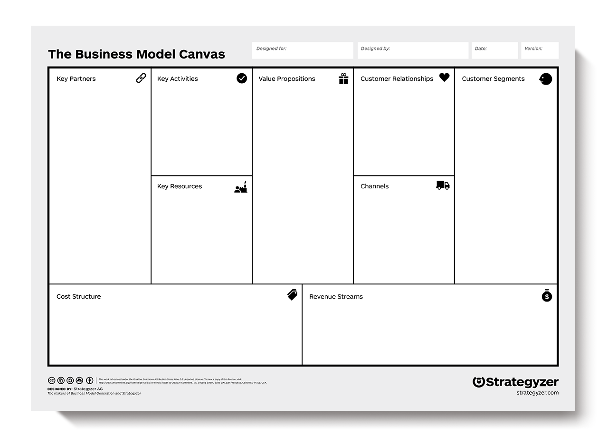
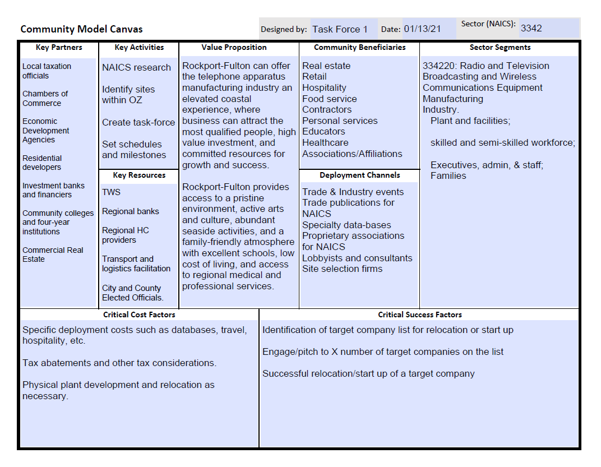
The Facilitating Our Future Series
TECHNOLOGY
B.M.C.
ARTS
B.M.C.
CASU MODEL
ENTREPRENEURSHIP
B.M.C.
MAKERSPACE
B.M.C.

Slide 6
The Facilitating Our Future Series
ACCESS | CURRICULUM | FUNDING | MANAGEMENT
Membership | Instructor Availability | Sustaining | Operations
Rules & Obligations | Mentoring | Event | Education
Health & Safety | Accreditation | Supplies & Consumables | Maintenance
Hours of Operation | Flexibility | Profitability | Security
While there are many, many aspects to be considered, it is important to discover, assemble, and test all policies, procedures, methods, and updates to insure currency, completeness, risk-tolerance, and updating.

Slide 7
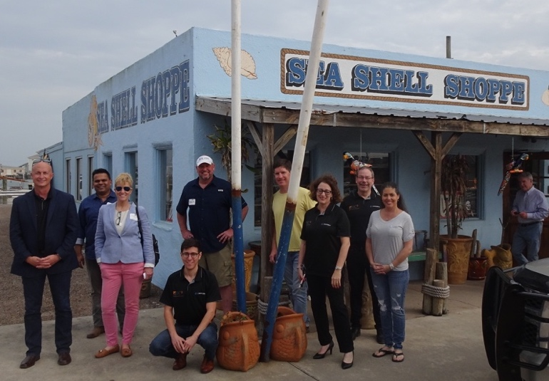
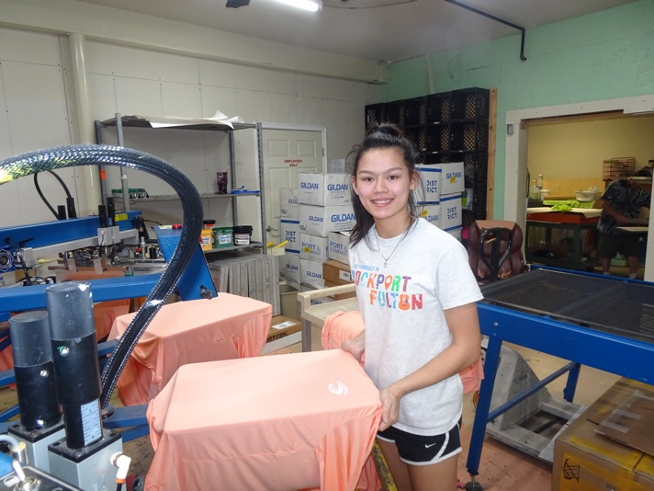
The Facilitating Our Future Series
Trying to set a linear path for entrepreneurial activity is an exercise in frustration, because entrepreneurship is a subjectivist shape-shifter.
Entrepreneurship is a way of thinking, reasoning, and acting that is opportunity obsesses, leadership balanced, and holistic in behavior that seeks to create value, deliver value, communicate value, and capture value for all participants and stakeholders.

Slide 8
The Facilitating Our Future Series
The Rockport-Fulton Value Proposition:
Rockport/Fulton is poised to offer visitors and residents an elevated coastal experience. By highlighting the access to Rockport/Fulton’s pristine environment, active arts community, abundant seaside activities, and family-friendly atmosphere, Rockport/Fulton can attract the people, investment, and resources it will need to build the economy for its future.

Slide 9
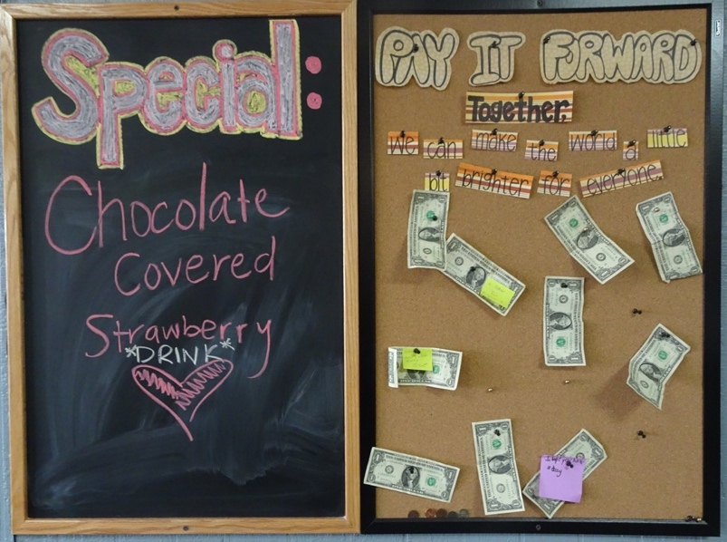
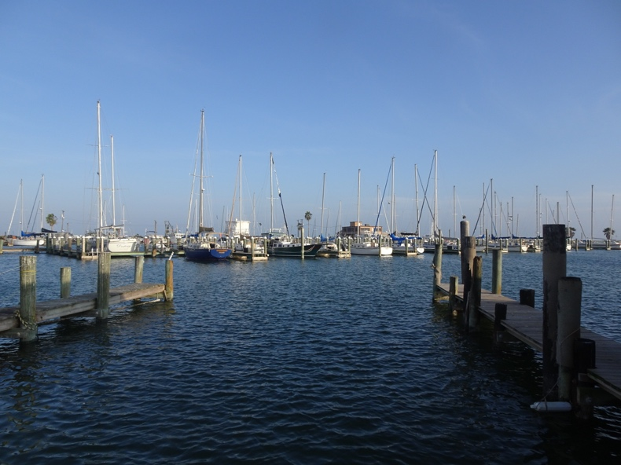
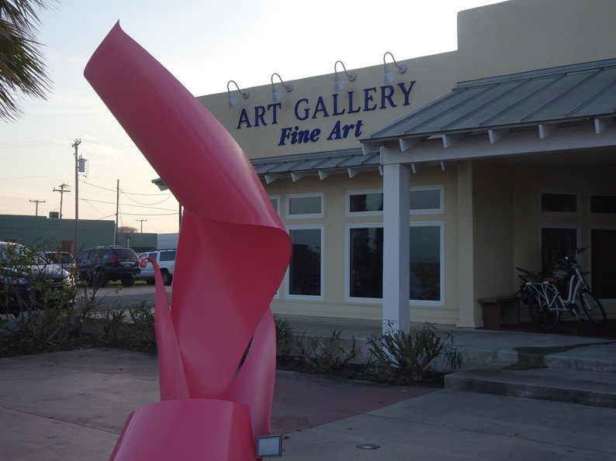
The Facilitating Our Future Series
Thank You for Your Participation.
Questions and Answers

