Slide 1
Crafting the Community Model Canvas as a Tool for Creating Competitive Advantage.

Slide 2
The Facilitating Our Future Series
StartUP enterprises and small businesses are at the core of the economic vitality of the Coastal Bend Region of Texas.
The “Communities As Start UP” (CASU) effort is an energy, activity, and innovation project that is designed to assist Rockport-Fulton as the community continues to emerge from Hurricane Harvey and the Covid-19 pandemic.
The core of the CASU program is to provide the community (as a whole) with the support to promote a robust entrepreneurial ecosystem.

Slide 3
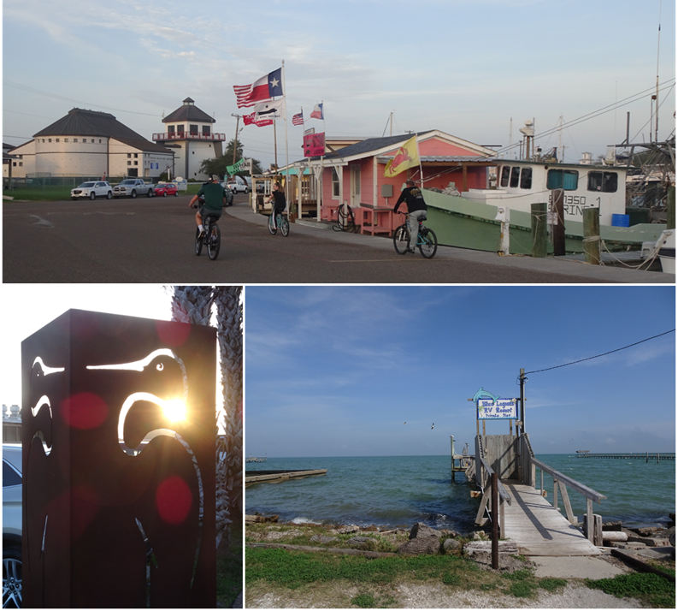
The Facilitating Our Future Series
The Rockport-Fulton Value Proposition: Rockport/Fulton is poised to offer visitors and residents an elevated coastal experience. By highlighting the access to Rockport/Fulton’s pristine environment, active arts community, abundant seaside activities, and family-friendly atmosphere, Rockport/Fulton can attract the people, investment, and resources it will need to build the economy for its future.

Slide 4
The Facilitating Our Future Series
Community Aspirations refer to the community resident’s shared goals, beliefs, and expectations. There are different categories of aspirations, each provide a greater understanding of the community. Based on a preliminary inquiry, the Rockport-Fulton residents aspire for a community that is:
Safe and Protected – a community that is free from violent crime, with first responders who work together to protect each person. Where people are physically safe and where medical and mental health care is available when needed. A community where communications and public utilities are both modern and reliable
Future Facing – a community that protects the natural beauty, with community leaders who work together to plan the future. Where there are strong public education opportunities for each child, and where everyone can enjoy good food and fun in a clean environment, with residents who can count on each other.
Diverse and Prosperous – a community that values work and where differences are respected. Where everyone can be successful and where people can secure good paying jobs.
Vibrant and Visionary – a community that is physically healthy, with easy access to outdoor activities. A community without the signs of aging/crumbling. A community with variety, energy, and enthusiasm that is innovative when confronting issues.
Supportive and Nurturing – a community where basic needs of everyone are met with a sense of order. A community that fuels creativity and where young people can find a job that is interesting and personally fulfilling.
Just Plain Popular – a community that everyone finds attractive and is well known by many different people.

Slide 5
The Facilitating Our Future Series
The Community Model Canvas (CMC)
A framework that will help to build and improve a community.
The CMC specifies nine building blocks needed to provide an overview of how a community responds, serves, and grows in a desired direction.
While the word community may mean something different to every person, the CMC concept is adaptive and flexible to meet the expectations for every community.
The CMC promotes a unified understanding of the relationships, the values, and resource requirements, the partnerships, the costs and the success factors needed, wanted and desired within and among community members.

Slide 6
The Facilitating Our Future Series
The CMC process is iterative and cascading.
A large-scale CMC guides the work of subordinate CMC activities.
Each CMC provides greater granularity and details for the community and the individual entities within the community.
The CMC process provides a methodology for creating and sustaining an entrepreneurial culture and ecosystem.
The CMC process is adaptive and focused on the most important aspects of growth, shared values, predictable expectations, and prosperity.

Slide 7
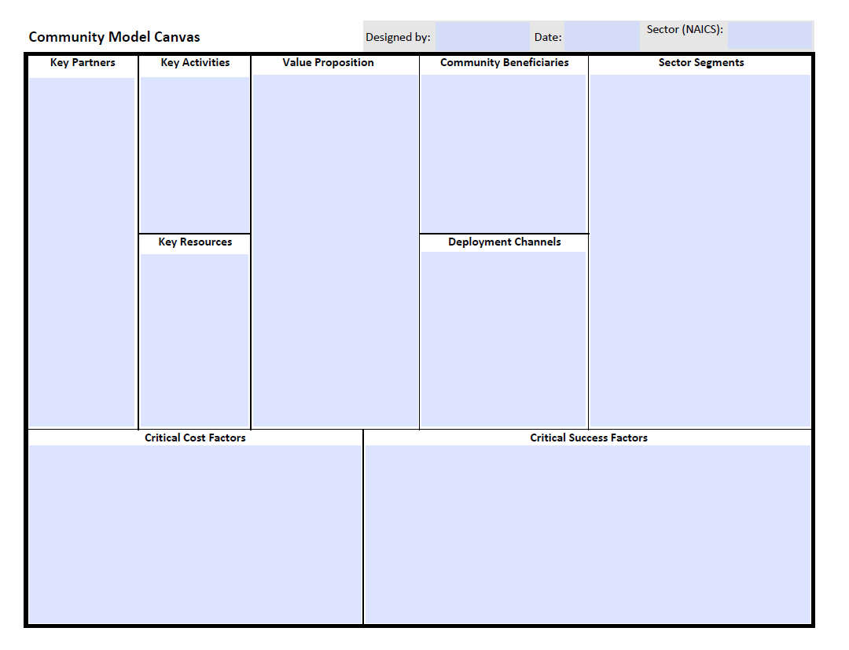
The Facilitating Our Future Series
3
7
1
5
2
6
4
8
9

Slide 8
The Facilitating Our Future Series
An Exercise in CMC Development
Assumptions:
Rockport-Fulton desires to attract small to mid-sized light technology manufacturing firms into the community to do business in each of the identified opportunity zones.
The firm size desired is between 5 and 20 employees with annual revenue of between $5 - $20 million for each firm.
The employment base is 50 percent managerial, administrative, & sales; 30 percent technical/skill-based; and 20 percent clerical, semi-skilled, & support.

Slide 9
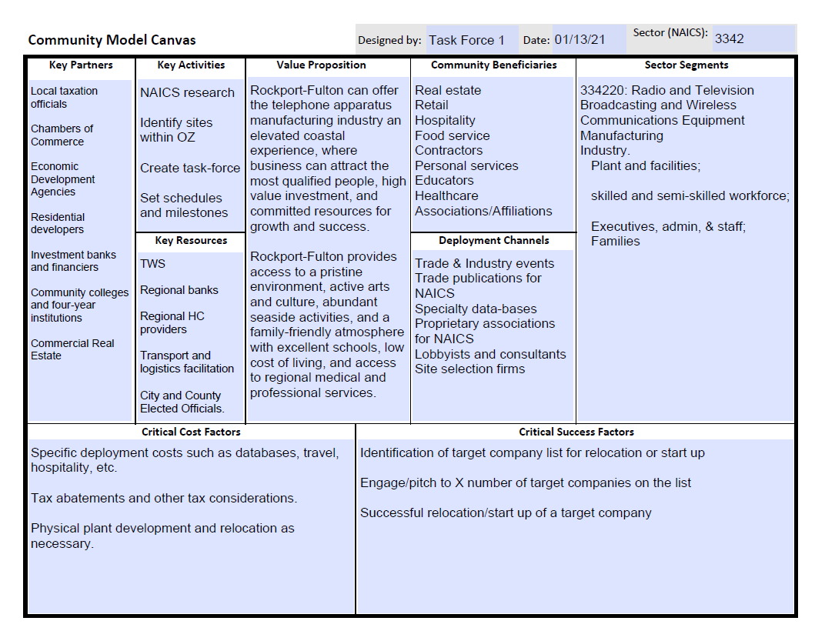

Slide 10
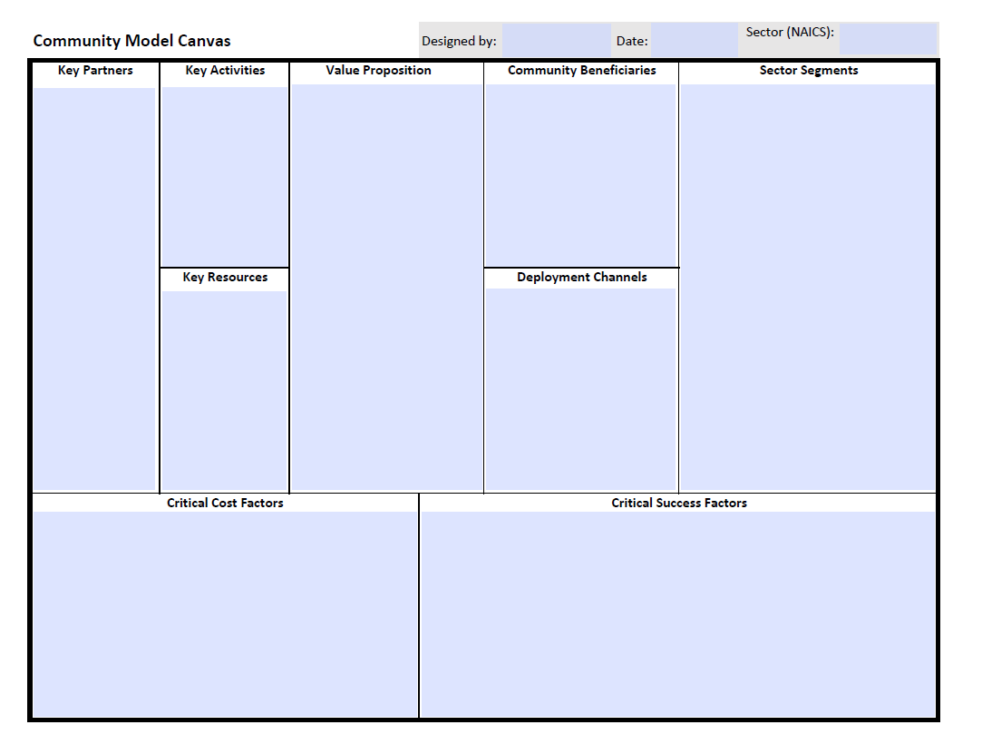

Slide 11
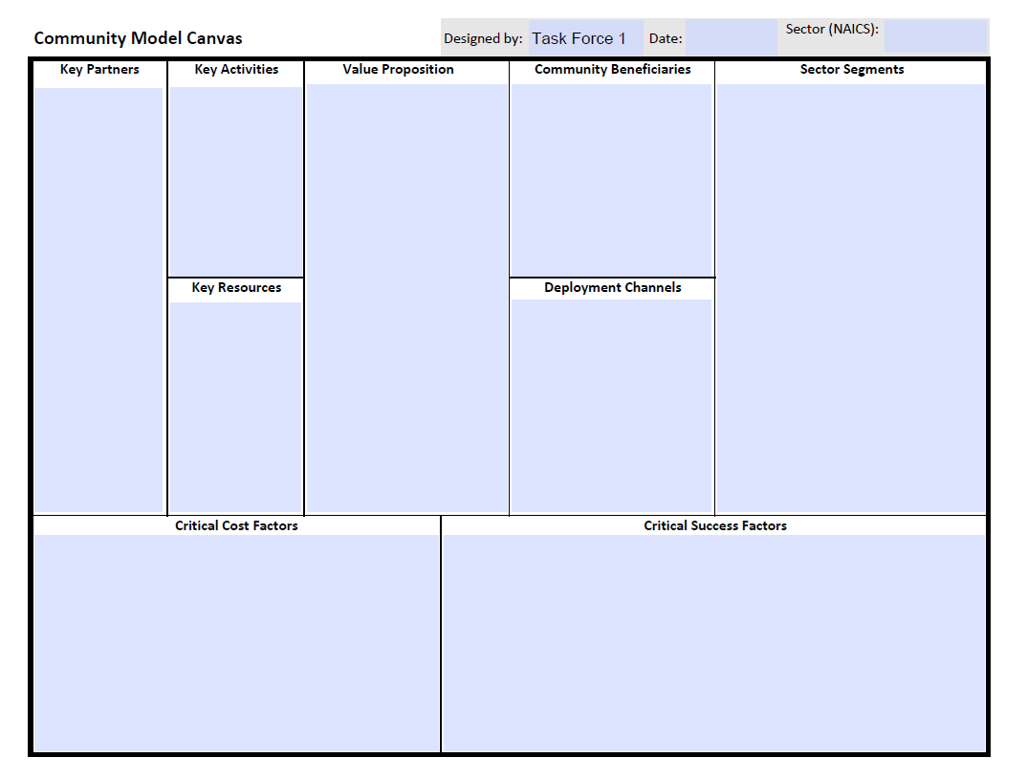
The originating entity.

Slide 12
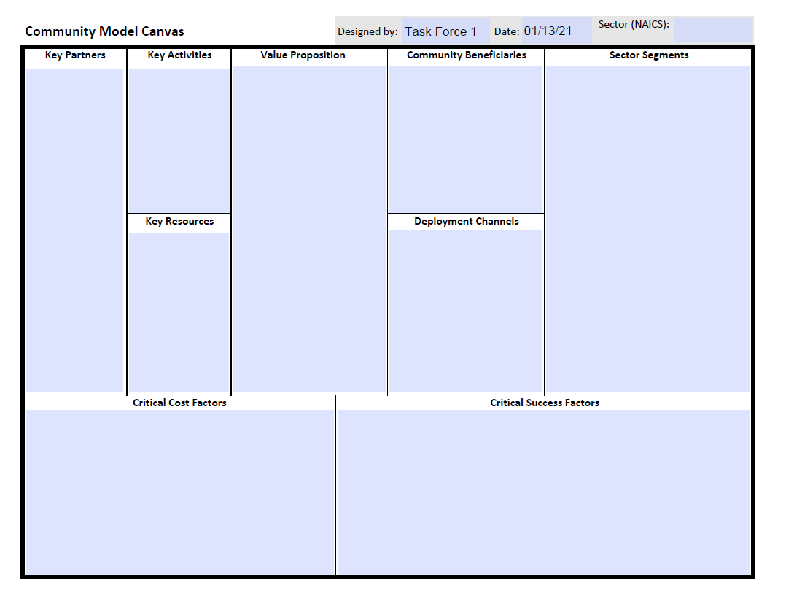
The date of the most recent edits or version

Slide 13
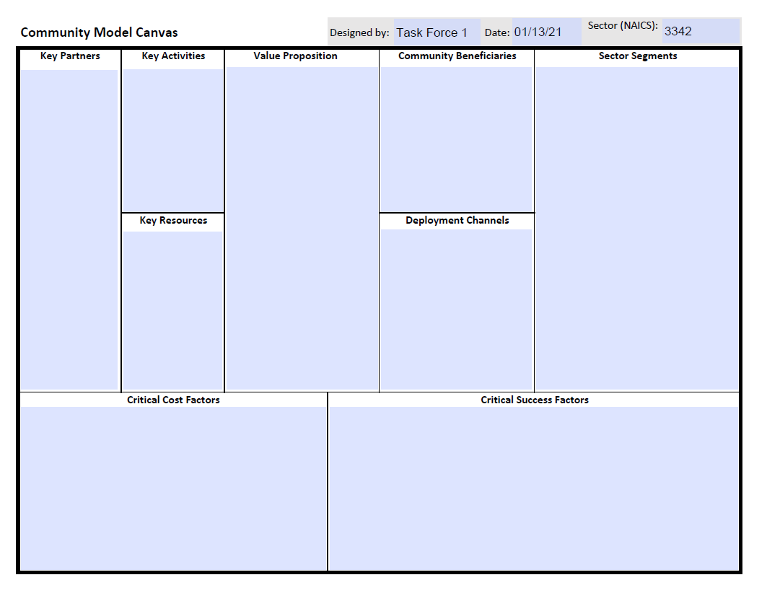
The NAICS sector or target audience

Slide 14
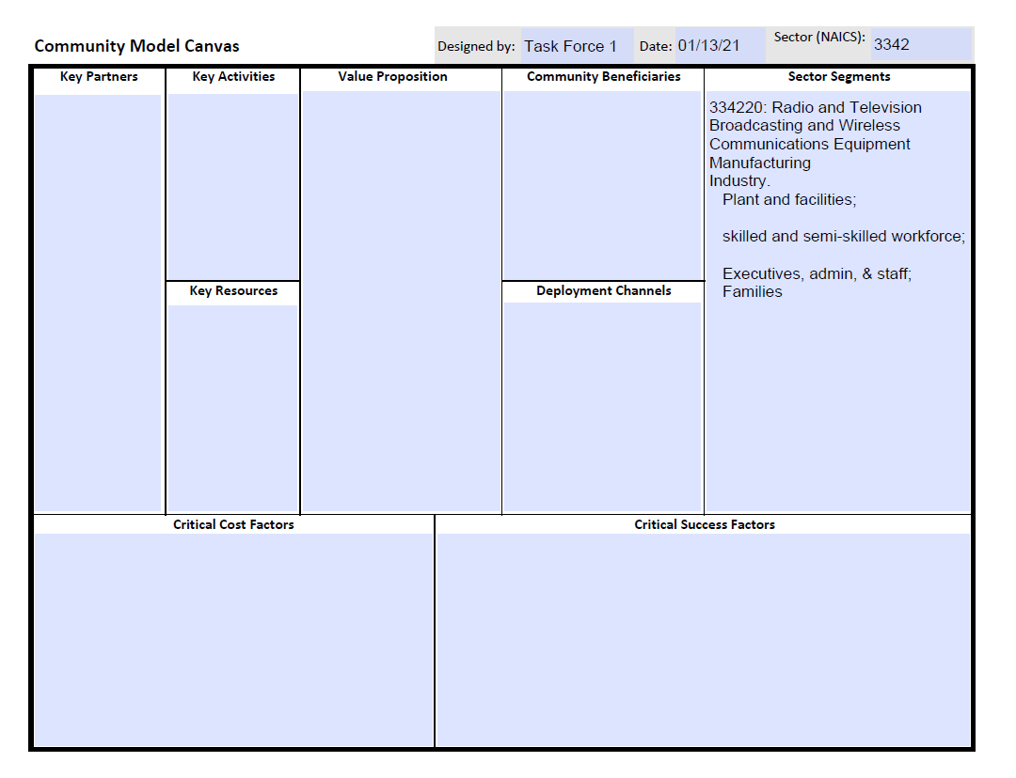
Identify the sector segment(s) to be served, attracted, or improved

Slide 15
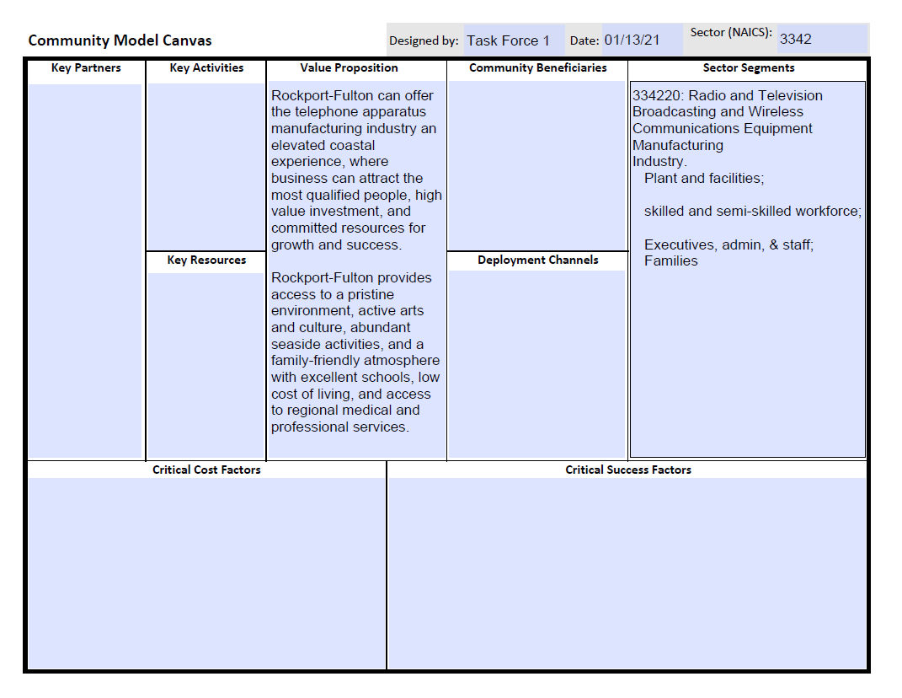
Aligns the specific value proposition(s) that are important to the sector segment(s)

Slide 16
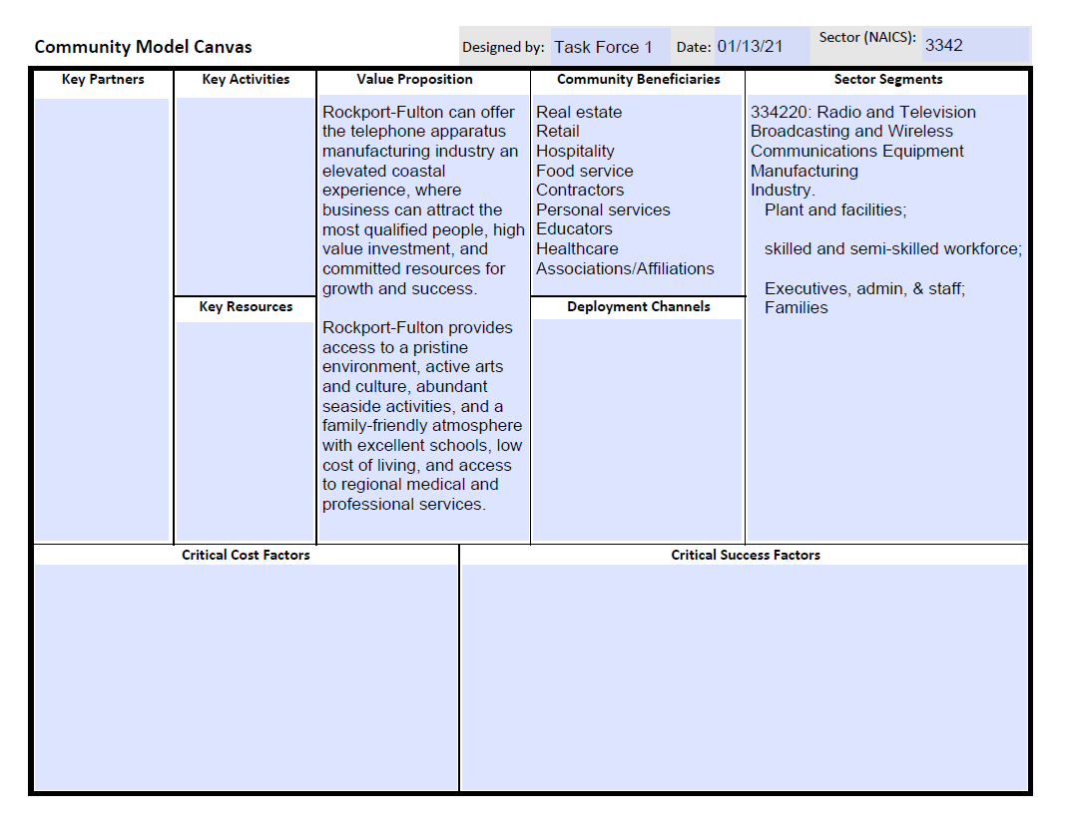
Specifies the community beneficiaries of the segment(s) when the value proposition is effectively aligned

Slide 17
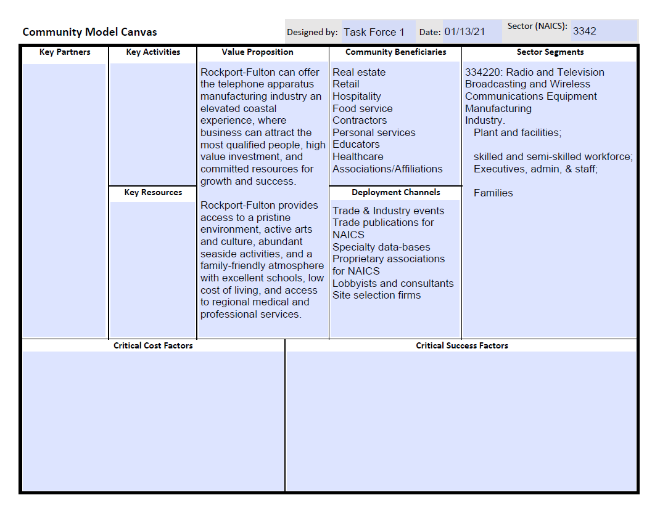
Describes the most logical and direct channels for communicating and distributing information/services to the segment(s)

Slide 18
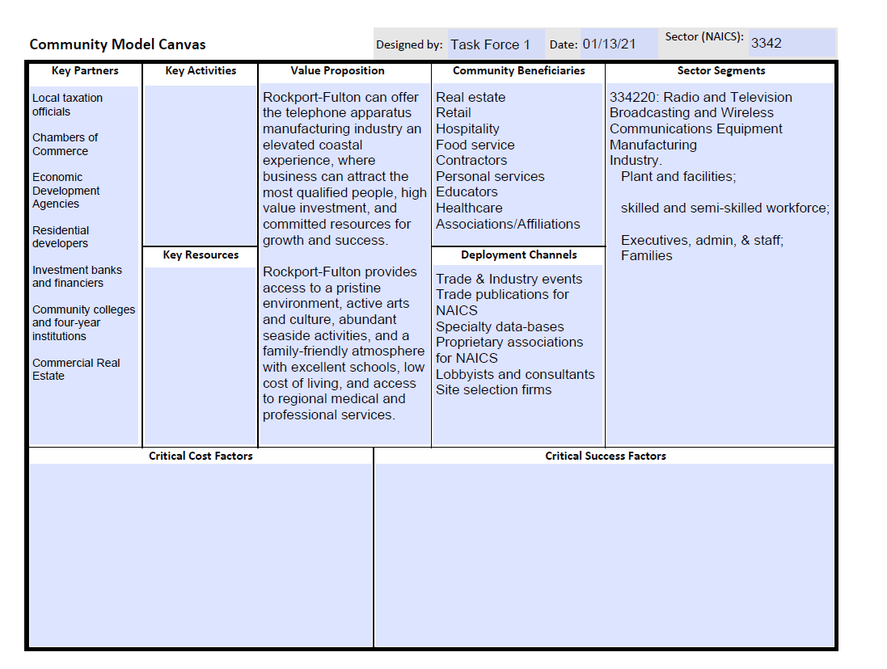
Creates an inventory of key partners within the community to insure the delivery/capability of the value proposition to the segment(s) with the deployment channels for the benefit of all community beneficiaries

Slide 19
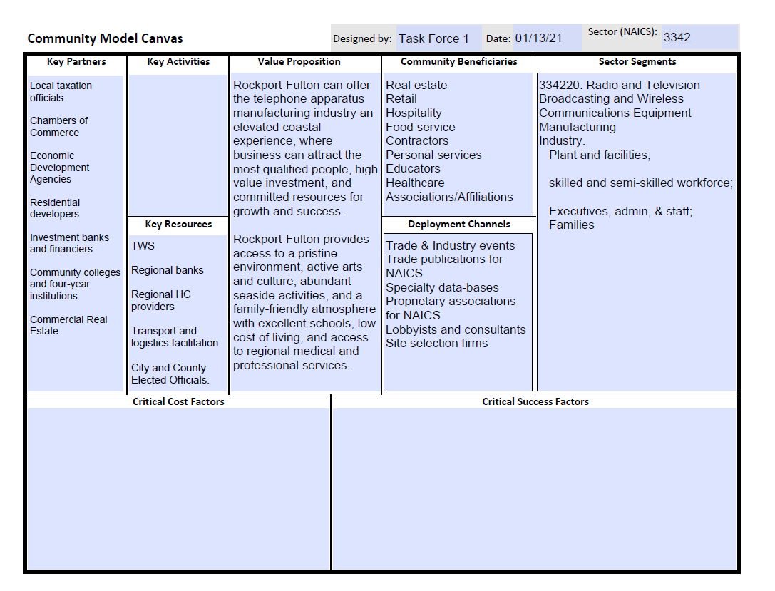
Lists the key resources: financial, human, social, and technological in support of the value proposition(s) for the segment(s)

Slide 20
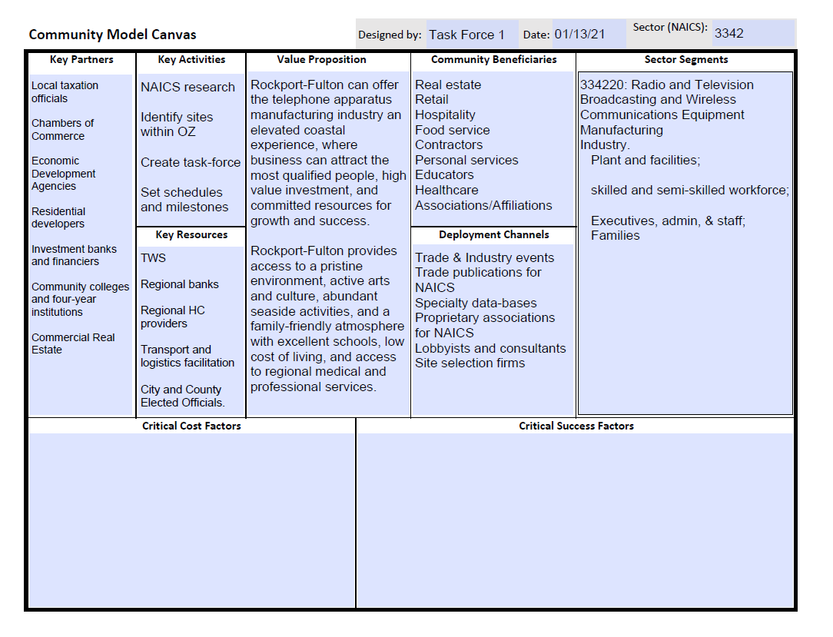
Presents an estimate of the key activities needed to operationalize the value proposition(s) for the segment(s)

Slide 21
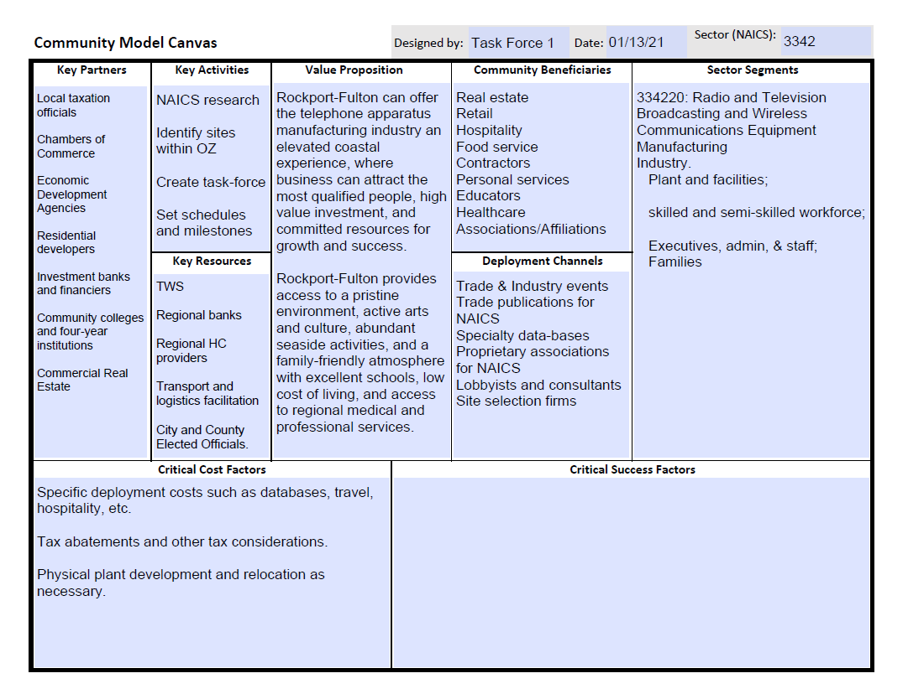
Focuses on the critical cost factors that are associated with implementing the value proposition(s) for the segment(s)

Slide 22
Creates an understanding of the critical success factors in alignment with the expectations of the community for providing the value proposition(s) to the segment(s)

Slide 24
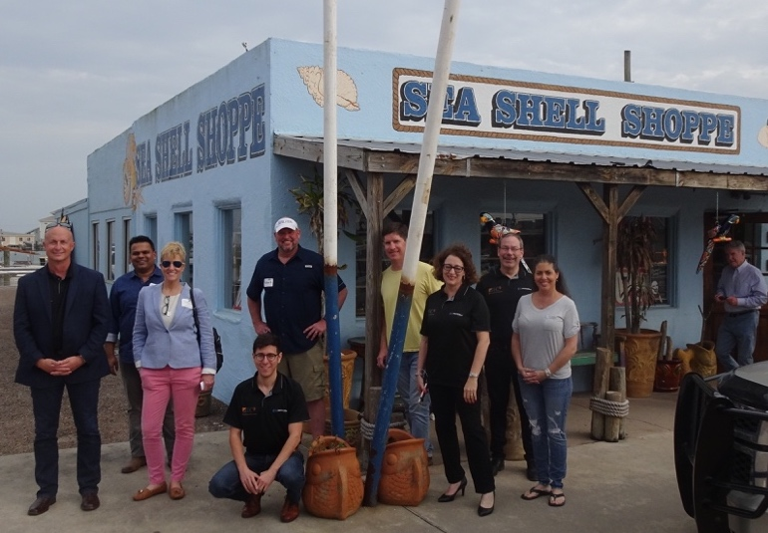
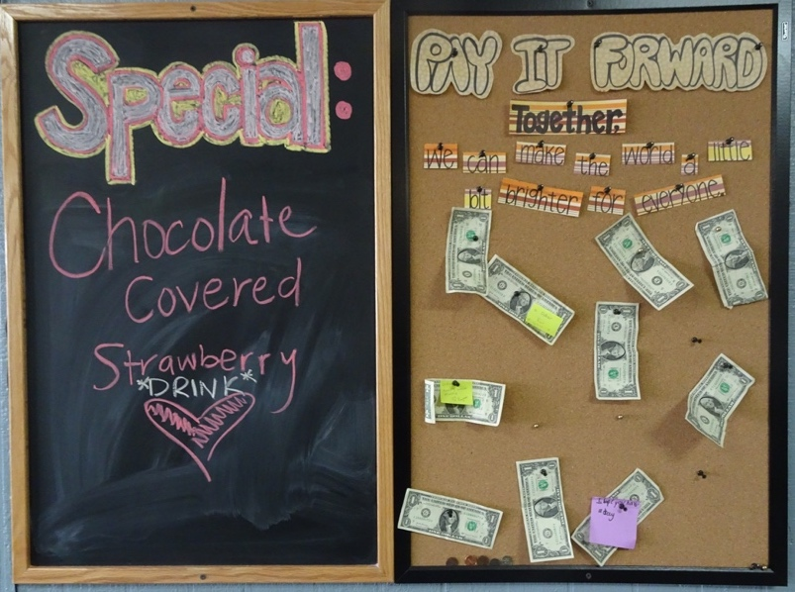
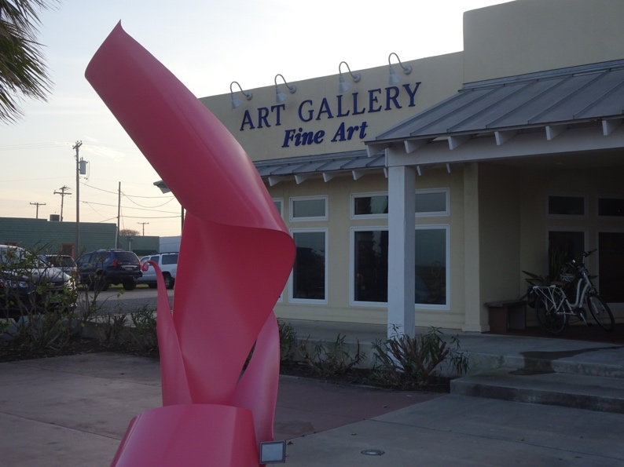
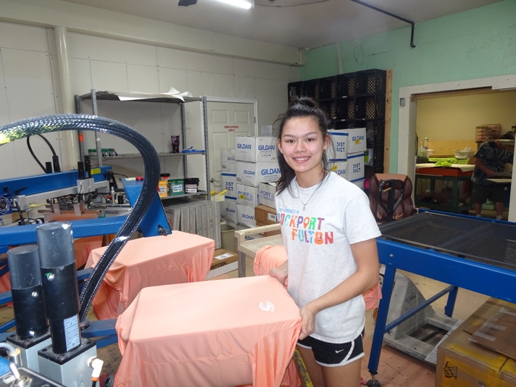
The Facilitating Our Future Series
Thank You for Your Participation.
Questions and Answers

