Slide 1
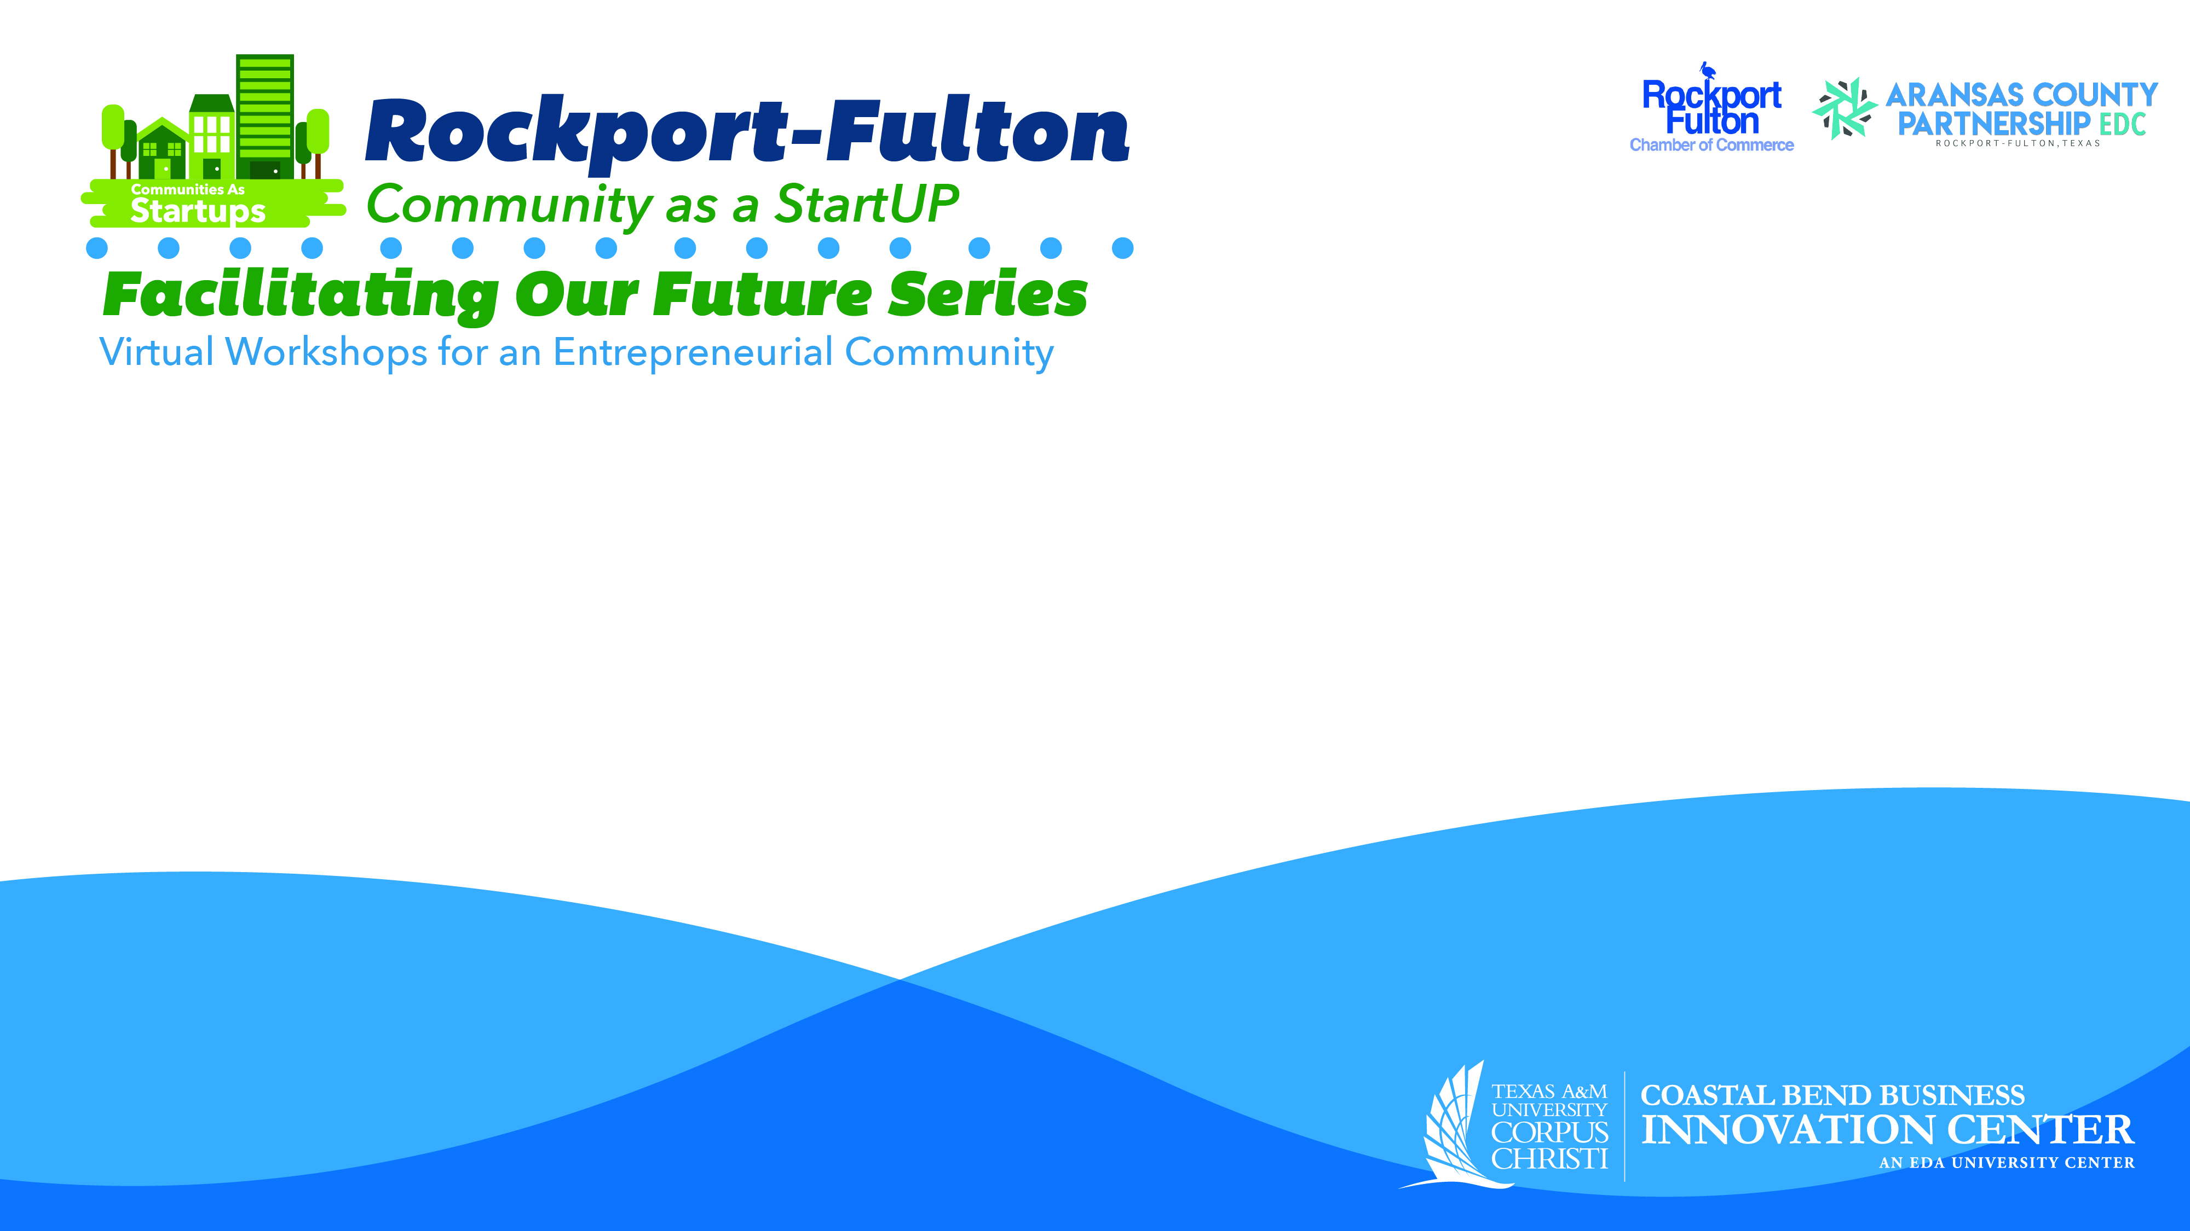
Exploring Community Aspirations;
A Foundation for Implementing the CASU Model

Slide 2

The Facilitating Our Future Series
StartUP enterprises and small businesses are at the core of the economic vitality of the Coastal Bend Region of Texas.
The “Communities As Start UP” (CASU) effort is an energy, activity, and innovation project that is designed to assist Rockport-Fulton as the community continues to emerge from Hurricane Harvey and the Covid-19 pandemic.
The core of the CASU program is to provide the community (as a whole) with the support to promote a robust entrepreneurial ecosystem.

Slide 3
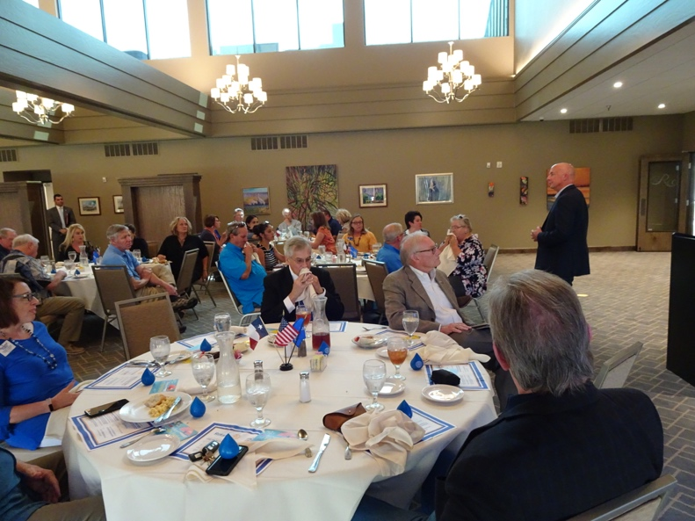
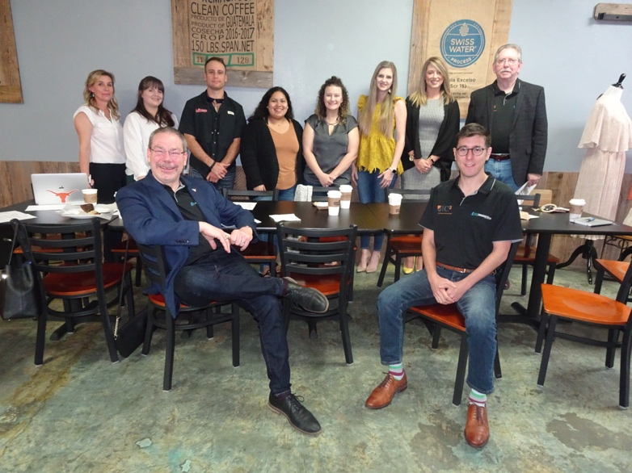
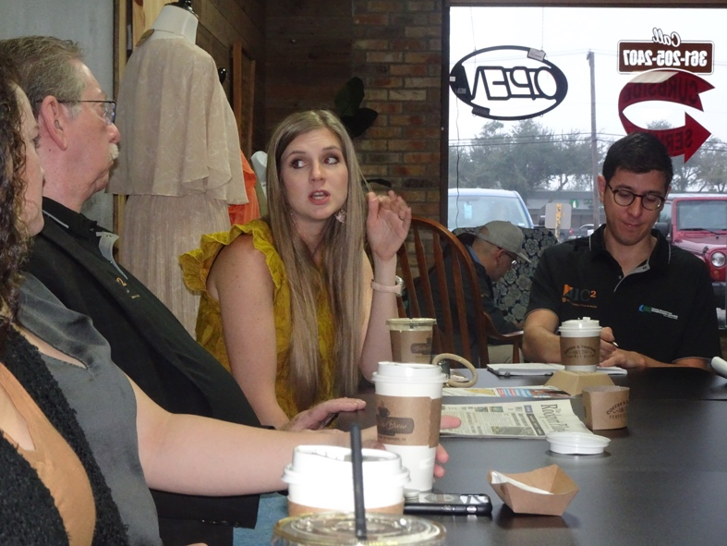
The Facilitating Our Future Series
Review of September 16, 2020
  Reviewed Phase 1:
  3-Day Leadership Discussions.
  Identified 16 Key Findings.
  Explained 4 Key Strategies.
  Specified 4 Significant Challenges.
  Delivered a Rockport-Fulton Value Proposition.
  Proposed 6 Consideration Points for Implementation.

Slide 4
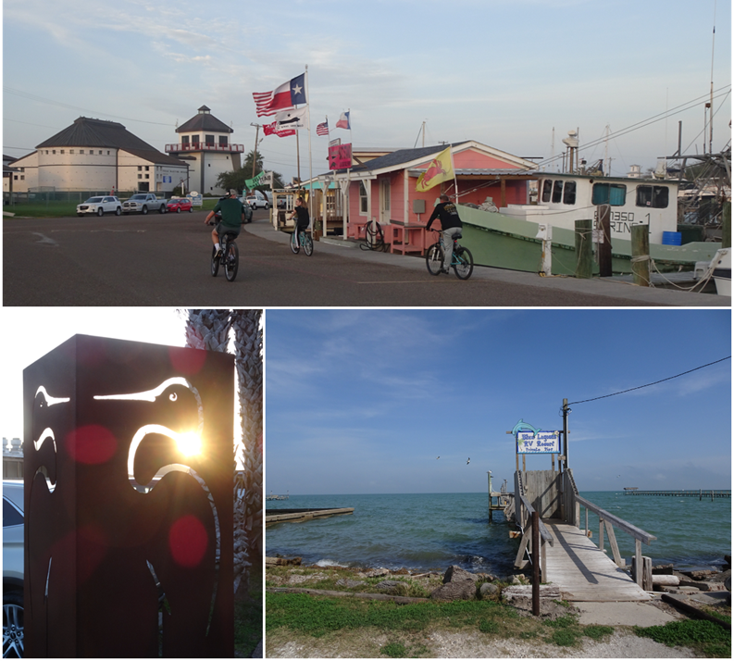
The Facilitating Our Future Series
The Rockport-Fulton Value Proposition:
Rockport/Fulton is poised to offer visitors and residents an elevated coastal experience. By highlighting the access to Rockport/Fulton’s pristine environment, active arts community, abundant seaside activities, and family-friendly atmosphere, Rockport/Fulton can attract the people, investment, and resources it will need to build the economy for its future.

Slide 5
The Facilitating Our Future Series
Community Aspirations refer to the community resident’s shared goals, beliefs, and expectations. There are different categories of aspirations, each provide a greater understanding of the community. These categories include:
  Community Prosperity
  Community Image
  Community Relationships
  Community Safety, and
  Community Health

Slide 6
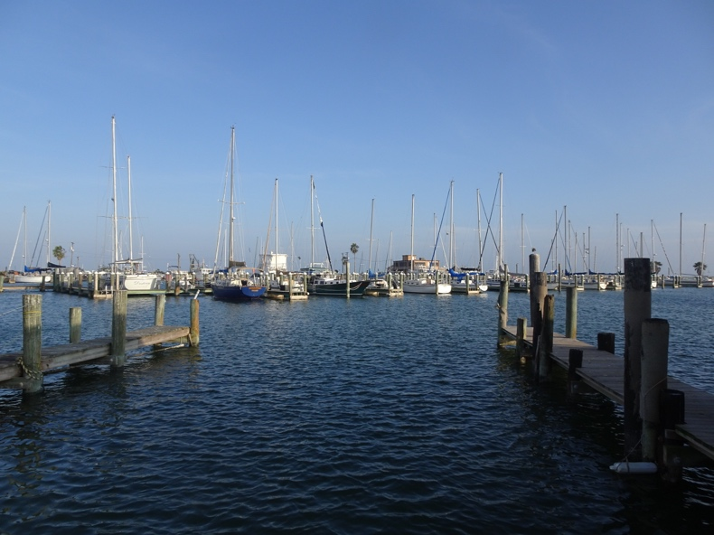
The Facilitating Our Future Series
Community aspirations reflects the shared hopes for the future of the Rockport-Fulton community based on common values and narratives.
Well-crafted community aspirations open hearts and empower minds to consider possibilities.
A solid set of community aspirations are navigational aids (North Star) to guide community action.
Community aspirations resonate with various organizations to align effort and common reference points when creating agendas.
Community aspirations can inspire and provide a sense of ownership.

Slide 7
The Facilitating Our Future Series
Community Aspirations Process
  The Rockport-Fulton Chamber of Commerce (RFCC) provided a database of 500 email addresses to the Coastal Bend Business Innovation Center (CBBIC).
  Three waves of invitations were sent out requesting responses to a survey sponsored by the RFCC, the Aransas County Partnership EDC (ACPEDC), and the CBBIC between September 17 and October 2, 2020.
  A total of 94 survey responses were collected with a total of 86 usable surveys available for analyses.
  Three major focus areas of the survey were:
    Community Aspirations
    Small Business Challenges
    Impact of Hurricane Harvey and Covid-19 Pandemic

Slide 8
The Facilitating Our Future Series

Slide 9
The Facilitating Our Future Series

Slide 10
The Facilitating Our Future Series

Slide 11
The Facilitating Our Future Series

Slide 12
The Facilitating Our Future Series

Slide 13
The Facilitating Our Future Series

Slide 14
The Facilitating Our Future Series
Putting It All Together
The Rockport-Fulton residents aspire for a community that is:
Safe and Protected – a community that is free from violent crime, with first responders who work together to protect each person. Where people are physically safe and where medical and mental health care is available when needed. A community where communications and public utilities are both modern and reliable
Future Facing – a community that protects the natural beauty, with community leaders who work together to plan the future. Where there are strong public education opportunities for each child, and where everyone can enjoy good food and fun in a clean environment, with residents who can count on each other.
Diverse and Prosperous – a community that values work and where differences are respected. Where everyone can be successful and where people can secure good paying jobs.
Vibrant and Visionary – a community that is physically healthy, with easy access to outdoor activities. A community without the signs of aging/crumbling. A community with variety, energy, and enthusiasm that is innovative when confronting issues.
Supportive and Nurturing – a community where basic needs of everyone are met with a sense of order. A community that fuels creativity and where young people can find a job that is interesting and personally fulfilling.
Just Plain Popular – a community that everyone finds attractive and is well known by many different people.

Slide 15
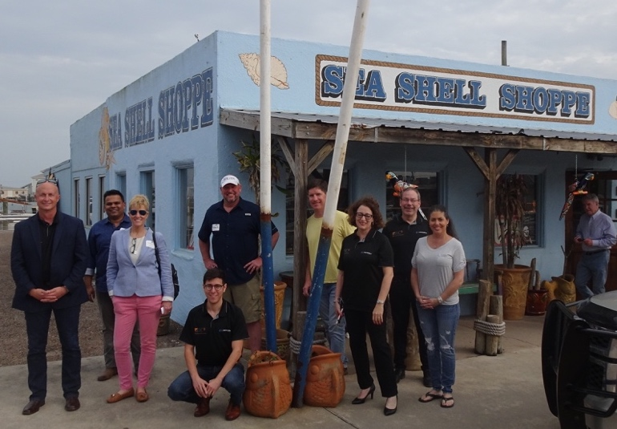
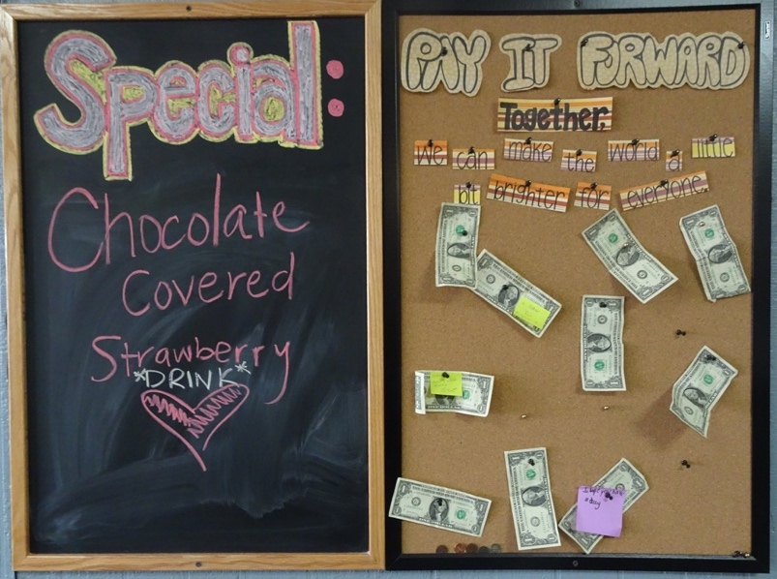
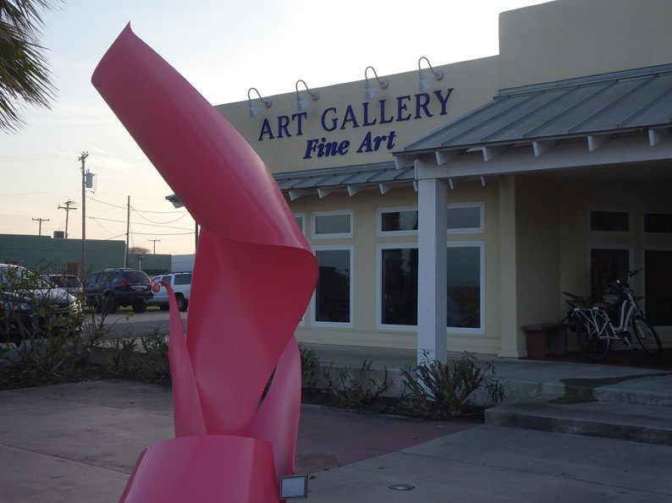
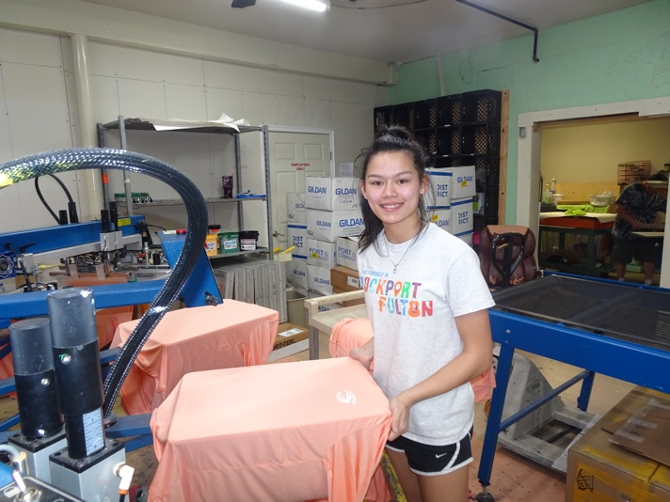
The Facilitating Our Future Series
Thank You for Your Participation.
Questions and Answers

