Slide 2
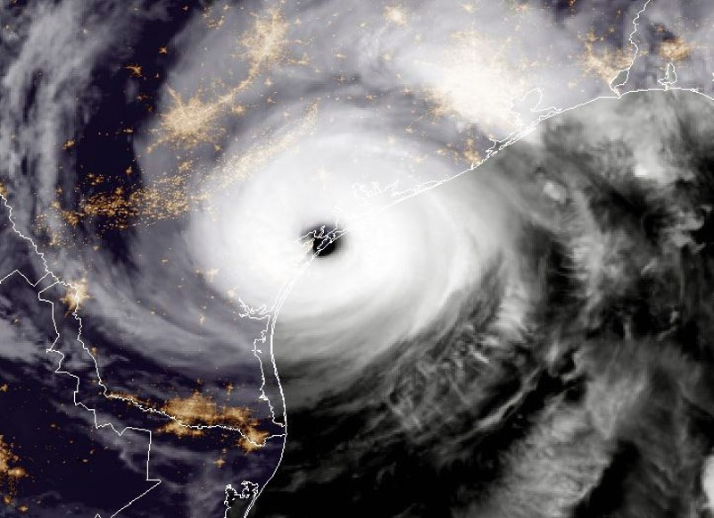
Shortly After 10:00 PM on
August 25, 2017
Hurricane Harvey Makes Landfall
B
(Photo by NASA/NOAA GOES Project via Getty Images)

Slide 3
In the aftermath of Hurricane Harvey, the College of Business at Texas A&M University-Corpus Christi mobilized to develop a meaningful contribution to the economic recovery of the Coastal Bend Region of Texas.
November 2017, National Rural Economic Development Conference in San Antonio introduction to Jordana Barton of the Federal Reserve Bank of Dallas-San Antonio office.
In March of 2018, the Coastal Bend Business Innovation Center (CBBIC) received a United States Economic Development Administration (EDA) grant to help facilitate the long-term economic recovery and resilience planning of the Presidentially Designated Area (PDA).
May 2018, the CBBIC and the Coastal Bend Council of Governments (COG) conducted a symposium to discuss the long-term planning needs of the adversely affected PDA communities.
“The Connected Coast Summit Series” will help to paint a vision and provide community leaders with information and assistance to achieve their goals for the future of the connected coast; our “String of Pearls.”

Slide 5
The Connected Coast Summit Series
Broadband Summit
September 20, 2018
The first of four summits to be offered by the CBBIC in collaboration with the United States Economic Development Administration.
THE OPPORTUNITIES:
The role that broadband plays in resilient community development.
THE PATH FORWARD:
An overview of the best practices for the use and expansion of broadband technology in economic development.
THE FUNDING:
An exploration of the various funding methodologies available in pursuit of broadband infrastructure.

Slide 6
An Overview of the Summit
Possibilities :
Delivering on Broadband Possibilities
Possibilities:
Own Your Destiny
Path Forward:
Lunch Keynote Highlighting an Oregon Community Case Study
Path Forward:
Developing Local Broadband Solutions
Funding:
Leveraging E-Rate and CRA Investments and Contributions
Funding:
Grants to Support Broadband Infrastructure and Economic Regional Sustainability

Slide 7
Welcome to the Broadband Summit
Session 1: Delivering on Broadband Possibilities:
Keynote Speaker: Jordana Barton; Senior Advisor
Federal Reserve Bank of Dallas, San Antonio Office

