Slide 1
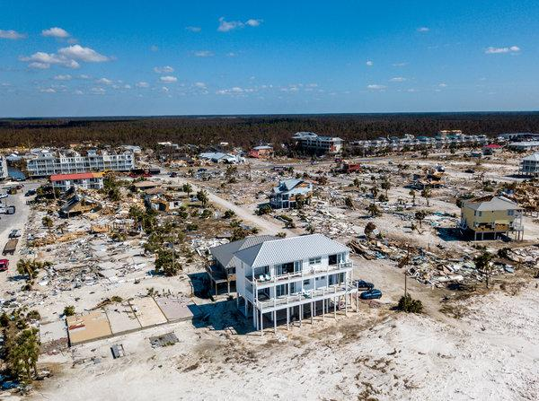
Should We Build for the “Big One”?
Amanda Torres Jim Lee
City of Rockport Texas A&M University-Corpus Christi
Photo Credit: Mexico Beach, Florida, after Hurricane Michael; taken by New York Times, 10/11/2018.

Slide 2
Notes:
IBHS = Institute for Business and Home Safety

Slide 3
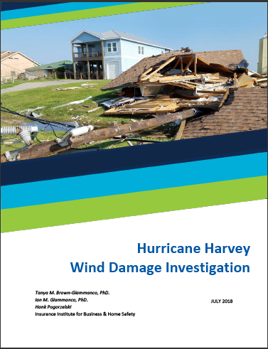

Slide 5
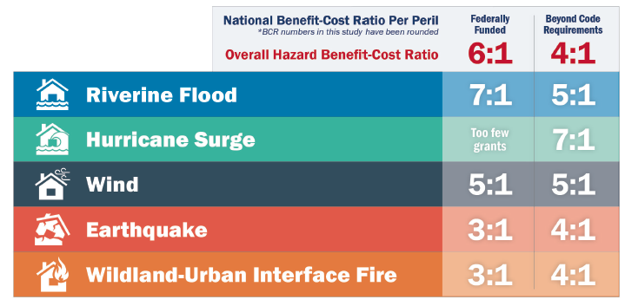
Mitigation Programs
Are the benefits worth the costs?
2017 Interim study of 2005 Mitigation Saves report by the National Institute of Building Sciences Multihazard Mitigation Council:
Benefit-Cost Ratio:

Slide 6
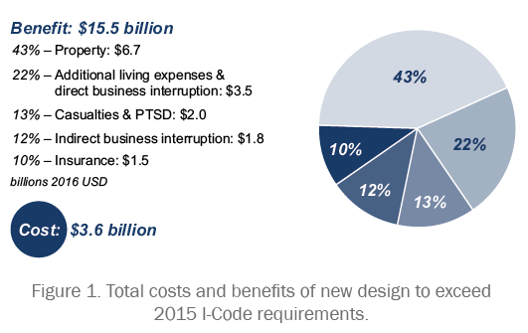
Mitigation Programs
Are the benefits worth the costs?
2017 Interim study of 2005 Mitigation Saves report by the National Institute of Building Sciences Multihazard Mitigation Council:
Benefit-Cost Ratio:

Slide 7
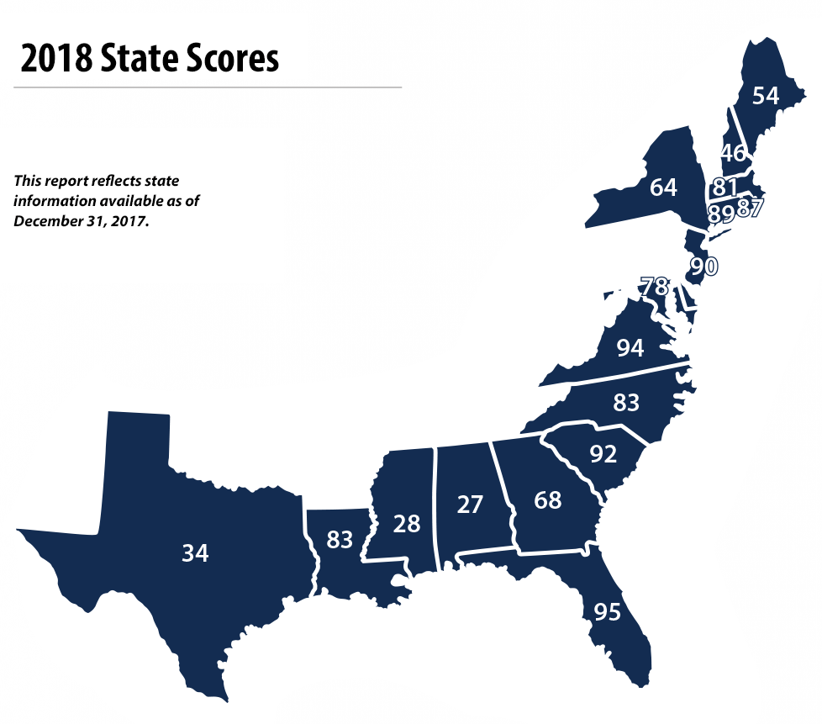
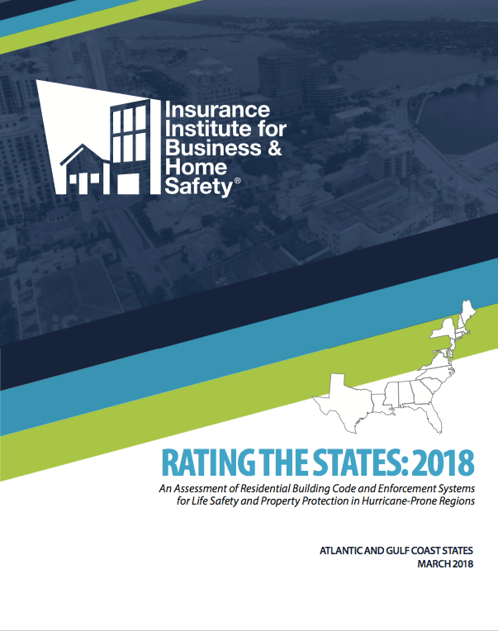
Building Code Assessment
IBHS evaluated 47 key data points to assess the effectiveness of the states’ residential building code programs:
code adoption and enforcement
building official training and certification
licensing requirements for construction trades

Slide 8
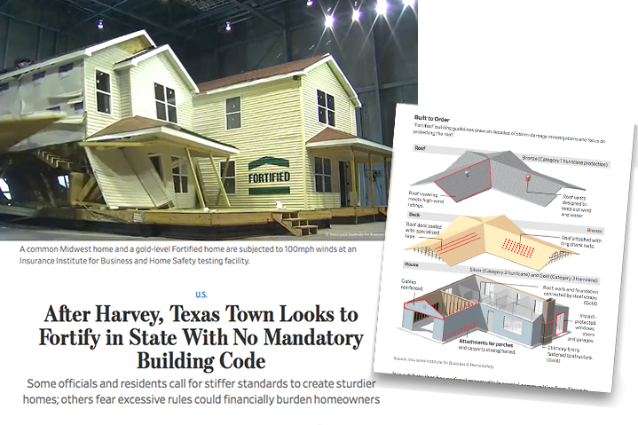

Slide 9
How do building standards matter?

Slide 10
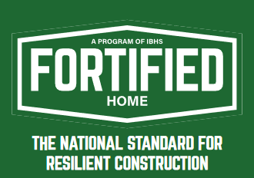
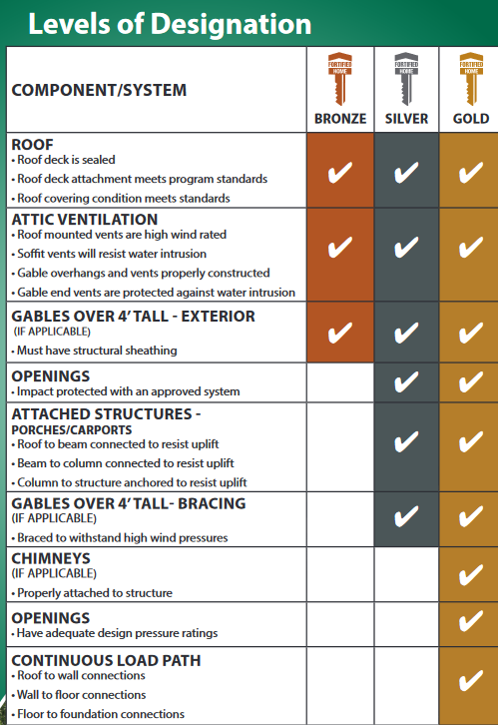
Economics of Higher Building Standards
Are the benefits worth the costs?
Costs
Up to 3% of new construction costs (lower for stricter existing building code)
Retrofits cost more at up to 24 cents per sq. ft.
FEMA’s P-804 program can fund up to 75% of project costs

Slide 11
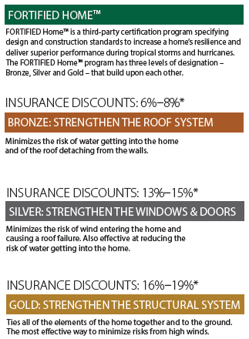
Economics of Higher Building Standards
Are the benefits worth the costs?
Benefits
Lower insurance premiums
Increases the value of a home by nearly 7%, holding all other variables constant (Univ. of Alabama study)
Reduces potential structural damage and personal property losses
Notes:
“Estimating the Effect of FORTIFIED Home™ Construction on Home Resale Value,” investigated the sales of 321 homes from 2004 to 2015, 22 percent of which were built or retrofitted according to FORTIFIED standards.

