Slide 1
Digital Inclusion for Economic Development
Jordana Barton, MPA
Federal Reserve Bank of Dallas-San Antonio Branch
jordana.barton@dal.frb.org
The Connected Coast Broadband Summit
by Coastal Bend Business Innovation Center
Heritage Place ● Rockport, Texas
September 20, 2018

Slide 2
“Technology is advancing so rapidly that . . . it is always going to outpace the law, the government or the public’s capacity to fully understand its ramifications. The genie is never going back into its flip phone. …Future startups are going to make decisions that will impact the lives of millions, defining the world the way religions and empires used to. iPhones and tweets and more convenient taxis were one thing. But the wave on the horizon now—artificial intelligence, genetic engineering, nanotechnology—will be something else entirely” -Steinmetz and Vella 2017, quoted in “Preparing Workers for the Expanding Digital Economy,” (Barton 2018).

Slide 3
“The dogmas of the quiet past are inadequate for
the stormy present...As our case is new, so we must
think anew, and act anew.”
— A. Lincoln 1862

Slide 4
The Fourth Industrial Revolution: The Future of Work is Here
Technological advancements are transforming the economy
Growth of automation & technological complexity are changing required job skills (i.e., manufacturing)
E-commerce and the disruptions in brick and mortar retail
Artificial intelligence advancements (augment labor → replace labor)
Remote models for provision of services (i.e., Telemedicine, Banking)
Growth in contingent workforce (i.e., gig economy)
3D printing

Slide 5
The Fourth Industrial Revolution: The Future of Work is Here
Algorithms
Brookings: “The rise of cognitive computing systems (Artificial Intelligence) brings . . . massive shift in the way that work is done, which could lead to an equally massive displacement of the workforce.”
Machines are impacting low- and medium-skill jobs by augmenting or completely replacing human labor.
Oxford: “47 percent of total U.S. employment is at a high risk of significant automation across blue-collar and white-collar professions.”
Choice at this inflection point: Luddites? Or advanced proactive digital citizens who understand the architecture of the digital world, and the ethical responsibilities thereof?

Slide 6
What is the Digital Divide?
The gap between people who have access to broadband services and know how to use the internet and those who do not have such access or knowledge.
Notes:
Refer to table regarding % of residents without access.
Boston (20%) compared to Detroit (40%)

Slide 7
Who does not have access?
The likelihood that a household has a broadband connection varies greatly depending upon its location.

Slide 8
U.S. Cities with 100,000+ Households Ranked by ‘Worst Connection’: Median Household Income vs. Percent of Households With No Fixed-Broadband Connection
Rank | City | Median Household Income | Percent of Households with no fixed internet access | Rank | City | Median Household Income | Percent of Households with no fixed internet access | Rank | City | Median Household Income | Percent of Households with no fixed internet access
1 | Detroit, Michigan | $26,249 | 57.3% | 26 | Arlington, Texas | $53,574 | 34.7% | 51 | Tampa, Florida | $45,874 | 27.7%
2 | Memphis, Tennessee | $36,975 | 49.9% | 27 | Oklahoma, Oklahoma | $50,070 | 34.0% | 52 | Long Beach, California | $55,151 | 27.6%
3 | Cleveland, Ohio | $26,583 | 49.2% | 28 | St. Paul, Minnesota | $50,820 | 33.7% | 53 | Columbus, Ohio | $47,156 | 26.8%
4 | Miami, Florida | $31,642 | 47.6% | 29 | Phoenix, Arizona | $49,328 | 33.6% | 54 | Lincoln, Nebraska | $51,126 | 25.9%
5 | New Orleans, Louisiana | $37,488 | 43.1% | 30 | Tucson, Arizona | $37,973 | 33.6% | 55 | Orlando, Florida | $44,007 | 25.5%
6 | Dallas, Texas | $45,215 | 42.3% | 31 | Fort Worth, Texas | $54,876 | 33.3% | 56 | Boston, Massachusetts | $58,516 | 25.2%
7 | Buffalo, New York | $33,119 | 42.2% | 32 | Atlanta, Georgia | $49,398 | 32.4% | 57 | Charlotte, North Carolina | $55,599 | 25.2%
8 | Milwaukee, Wisconsin | $36,801 | 42.1% | 33 | Mesa, Arizona | $50,615 | 32.2% | 58 | St. Petersburg, Florida | $48,183 | 25.0%
9 | Baltimore, Maryland | $44,262 | 41.6% | 34 | Jacksonville, Florida | $48,256 | 32.0% | 59 | Denver, Colorado | $56,258 | 24.7%
10 | Indianapolis, Indiana | $43,101 | 40.8% | 35 | Fort Wayne, Indiana | $44,449 | 31.8% | 60 | Lexington-Fayette, Kentucky | $50,661 | 24.4%
11 | Greensboro, North Carolina | $42,802 | 39.4% | 36 | Los Angeles, California | $51,538 | 31.6% | 61 | Austin, Texas | $60,939 | 24.3%
12 | Philadelphia, Pennsylvania | $39,770 | 39.4% | 37 | Omaha, Nebraska | $50,827 | 31.5% | 62 | Portland, Oregon | $58,423 | 23.7%
13 | Toledo, Ohio | $34,548 | 38.8% | 38 | Las Vegas, Nevada | $50,882 | 31.3% | 63 | Colorado Springs, Colorado | $56,227 | 23.4%
14 | Houston, Texas | $47,010 | 38.2% | 39 | Louisville/Jefferson, Kentucky | $46,881 | 31.2% | 64 | Henderson, Nevada | $64,277 | 22.6%
15 | San Antonio, Texas | $48,183 | 38.2% | 40 | New York, New York | $55,191 | 30.7% | 65 | San Diego, California | $68,117 | 21.6%
16 | St. Louis, Missouri | $36,809 | 37.8% | 41 | Nashville-Davidson, Tennessee | $49,891 | 30.6% | 66 | San Francisco, California | $87,701 | 20.8%
17 | Cincinnati, Ohio | $34,629 | 37.3% | 42 | Pittsburgh, Pennsylvania | $42,450 | 30.6% | 67 | Madison, Wisconsin | $56,464 | 19.7%
18 | El Paso, Texas | $43,322 | 37.1% | 43 | Bakersfield, California | $58,669 | 30.1% | 68 | Anchorage municipality, Alaska | $80,862 | 19.4%
19 | Tulsa, Oklahoma | $43,045 | 36.3% | 44 | Oakland, California | $57,778 | 30.1% | 69 | Virginia Beach, Virginia | $67,719 | 19.3%
20 | Fresno, California | $41,842 | 36.1% | 45 | Washington, District of Columbia | $72,935 | 29.7% | 70 | San Jose, California | $90,303 | 18.2%
21 | Chicago, Illinois | $50,434 | 35.9% | 46 | Aurora, Colorado | $55,303 | 29.6% | 71 | Raleigh, North Carolina | $58,641 | 18.1%
22 | Kansas, Missouri | $47,489 | 35.6% | 47 | Honolulu, Hawaii | $63,361 | 29.5% | 72 | Seattle, Washington | $74,458 | 17.4%
23 | Albuquerque, New Mexico | $48,127 | 35.3% | 48 | Sacramento, California | $52,071 | 29.4% | 73 | Scottsdale, Arizona | $76,543 | 16.5%
24 | Corpus Christi, Texas | $52,154 | 35.3% | 49 | Minneapolis, Minnesota | $52,611 | 28.5% | 74 | Plano, Texas | $85,085 | 15.9%
25 | Wichita, Kansas | $46,775 | 34.9% | 50 | Durham, North Carolina | $52,115 | 28.4% | 75 | Arlington, Virginia | $108,706 | 15.6%
Source : US Census, American Community Survey, 2016. Jordana Barton, Federal Reserve Bank of Dallas

Slide 9
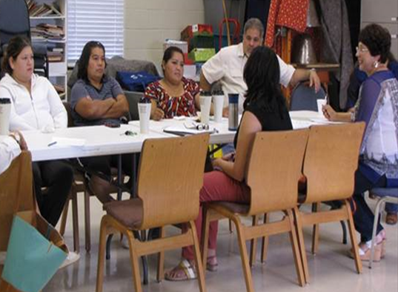
Broadband: A Platform for all Areas of Community Economic Development
Essential Infrastructure
Public Safety
Workforce Development and
Education
Access to Financial Services
Small Business Development
Affordable Housing
Health Care
Civic Engagement

Slide 10
Broadband is Essential Infrastructure and the Prerequisite for Closing the Digital Divide
Notes:
What would need to be included in a digital inclusion plan?
What if there was no broadband infrastructure (already) in place?

Slide 11
The Internet Economy

Slide 12
The Homework Gap
1/3 of households with incomes below $50,000, with school age children, do not have high speed internet access at home (40% of all families with school-age children)
Only 8% of households with incomes of $50,000 or more lack broadband at home
Notes:
-digital skills (ability to use the internet to find information) and internet access
-knowing how a computer works
-being digitally prepared for a career in opportunity occupations (middle skills jobs) above national living wage of $15
8/10 require digital skills = 32% of labor demand in the nation

Slide 13
Workforce Development
Digital skills & access to broadband required for accessing jobs & training
70% of jobs are posted online
Job training programs increasingly offered online
8 in10 middle skills jobs require digital skills (32% of labor market demand)
Digitally intensive middle skills jobs have grown twice as fast as other middle skills jobs in the past decade (higher wages)
Automation, e-commerce, digital divide, digital skills gap→ the shrinking middle class and job polarization

Slide 14
The Shrinking Middle Class: Job Polarization in the United States
High-Skill Occupations
Traditional Middle-Skill Occupations
Low-Skill Occupations
THE VANISHING MIDDLE
Job Polarization in the United States
25%
39%
Percent of U.S. Workforce by Occupation Skill Level
61%
43%
14%
18%
NOTE: Data are restricted to workers ages 16 to 64 who are not self-employed and are not employed in military or agricultural occupations. SOURCE: The original chart is from “The Vanishing Middle: Job Polarization and Workers’ Response to the Decline in Middle-Skill Jobs,” Didem Tuzemen and Jonathan Willis, Federal Reserve Bank of Kansas City, 2013. The original chart has been updated to begin in 1979 and end in September 2016. Data was provided by Didem Tuzeman.
Notes:
There has been a lot of discussion about the shrinking middle class.
What does this mean?
This graph shows that over the past 3 decades the share of middle-skill jobs has been shrinking in the US
these are jobs that require workers to perform repetitive and procedural tasks
While the share of the middle-skill jobs is still the largest share of jobs in the economy, job growth for middle-skill jobs is slowing
This is happening largely because computers and other machines are increasingly doing these routines more efficiently and effectively
At the same time, some of these jobs are moving overseas
This trend – “job polarization” – has forced millions of American workers to make a choice:
1. either get more education and workforce training required for new middle- and high-skill occupations
2. settle for a lower-wage job in low-skill occupations, or
3. drop out of the labor force

Slide 15
Low Wage Jobs and the Shrinking Middle Class
Low Wage Jobs and the Declining Middle Class
NOTES: Calculations include workers over age 15 with positive wages and exclude the self-employed. Quartiles based on the Texas and US wage distributions from the 1980 decennial census, which refers to 1979 wages. SOURCES: 1980 Census; 2015 ACS; “Employment Growth and Labor Market Polarization,” Chapter 7, Ten-Gallon Economy: Sizing Up Economic Growth in Texas by Pia M. Orrenius Jesús Cañas and Michael Weiss, 2015.
Notes:
Texas’ trends are like the rest of the country’s
Share of middle wage jobs is falling

Slide 16
Business Development
“Uber, the world’s largest taxi company, owns no vehicles. Facebook, the world’s most popular media owner, creates no content. Alibaba, the most valuable retailer, has no inventory. And, Airbnb, the world’s largest accommodation provider, owns no real estate. Something interesting is happening.”
–Tom Goodwin, Havas Media

Slide 17
Business Development in Low- and Moderate-Income Areas and Rural Areas
Broadband infrastructure and workers who have digital skills (supply side) are necessary to attract business and industry, i.e., jobs (demand side) to underserved communities.
Broadband infrastructure and digital inclusion: The ecosystem for entrepreneurship.
Small business has been responsible for about 65 percent of job gains over the past 25 years (U.S. Bureau of Labor Statistics 2017).
The key to growing entrepreneurship in the digital economy is to promote the expansion of broadband networks.
The intelligence of the network is now on the periphery—with a person and their computer (and a little knowledge of coding).
Business platforms, efficiencies, and the expansion of the customer base

Slide 18
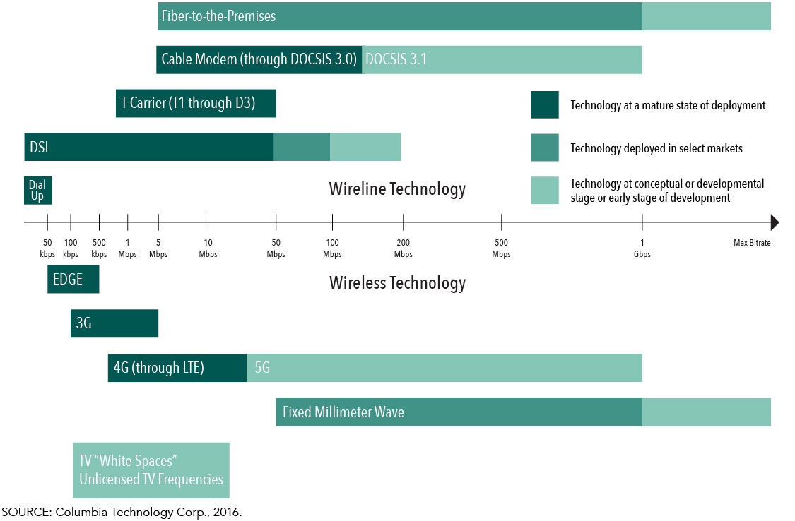
Economic Development: Importance of Broadband Speed and Capacity
Designed and updated by Jordana Barton, Federal Reserve Bank of Dallas, 2017. Source: CTC Technology and Energy

Slide 19
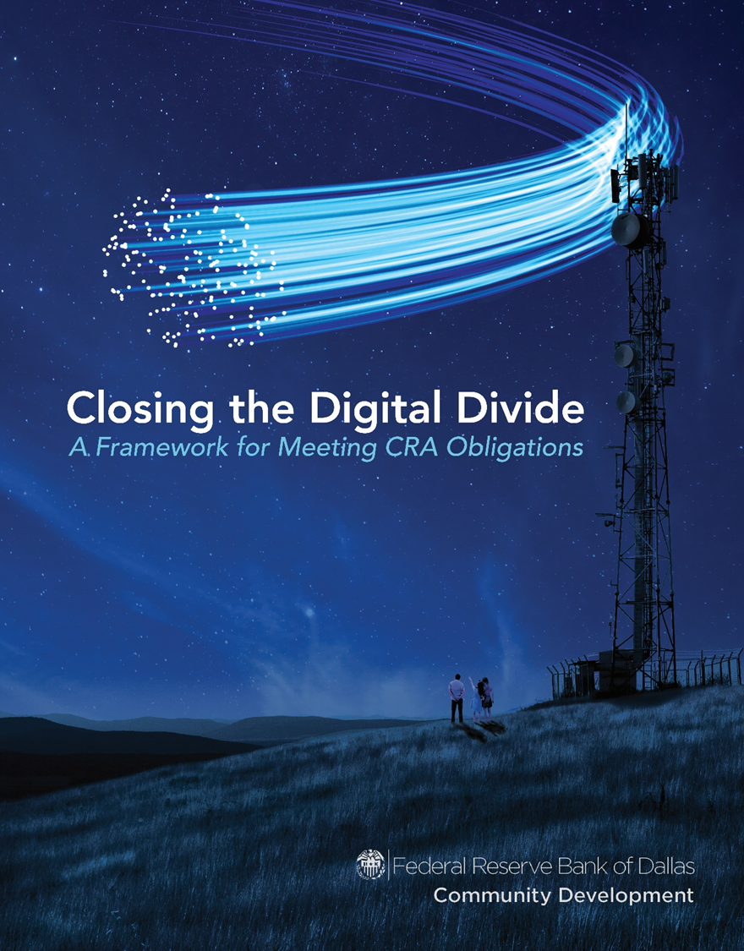
Related Research & Publications
“Closing the Digital Divide: A Framework for Meeting CRA Obligations”
“Preparing Workers for the Expanding Digital Economy”
“Telehealth Along the Texas-Mexico Border”
“Telehealth Initiatives Highlight Need to Close the Digital Divide”

Slide 20
Conclusion
Income and wealth inequality are at the highest levels since the Great Depression. The top 3% account for 30.5% of all income and hold 54.4% of all the net worth.
The Digital Divide creates a structural barrier to closing the income and wealth gaps—and a barrier to LMI individuals’ ability to move up the economic ladder. The Gatsby Curve: The finding that greater income inequality is associated with diminished intergenerational mobility.
Local governments, nonprofits, business, banks, and anchor institutions can work together to bring broadband access and adoption to low- and moderate-income and rural communities.

Slide 21
Q & A
Jordana Barton, MPA
Federal Reserve Bank of Dallas
& Digital Inclusion Alliance San Antonio
jordana.barton@dal.frb.org
“Closing the Digital Divide”
www.fedcommunities.org , or www.dallasfedcomdev.org
“Preparing Workers for the Expanding Digital Economy” www.investinwork/book.org

Slide 22
Closing the Digital Divide: A Framework for Meeting CRA Obligations
Jordana Barton, MPA
Federal Reserve Bank of Dallas-San Antonio Branch
jordana.barton@dal.frb.org
The Connected Coast Broadband Summit
by Coastal Bend Business Innovation Center
Heritage Place ● Rockport, Texas
September 20, 2018

Slide 23
The Community Reinvestment Act (CRA)
Federal law passed in 1977 to address redlining—the denial of credit to individuals based on where they live.
Encourages banks to make loans and investments and provide services in low- and moderate-income (LMI) communities, underserved communities, and disaster areas.
Intended to be broad, flexible and responsive to changes within communities.

Slide 24
2016 Interagency Question & Answer Q&A Guidance
Broadband is included as a form of infrastructure investment—an essential community service.
Under the CRA service test, banks should show evidence that their “alternative delivery systems” using online, mobile banking and financial technology are being adopted and are effective in providing services to LMI individuals.
Digital Inclusion:
Workforce Development was already included in CRA. Digital skills, preparing workers for the digital economy; Closing the homework gap; Attracting business/jobs/the ecosystem for entrepreneurship
Small Business Development was already included in CRA. Added an example to include supporting technical assistance for businesses in the use of technology
Expanding access to financial services/access to capital for small business through digital technology

Slide 25
2016 Interagency Q&A Guidance
To accompany the 2016 Q & A, the Fed published “Closing the Digital Divide: A Framework for Meeting CRA Obligations” to provide the “Why” and “How” for banks and their community partners. Visit: www.fedcommunities.org or www.dallasfedcomdev.org

Slide 26
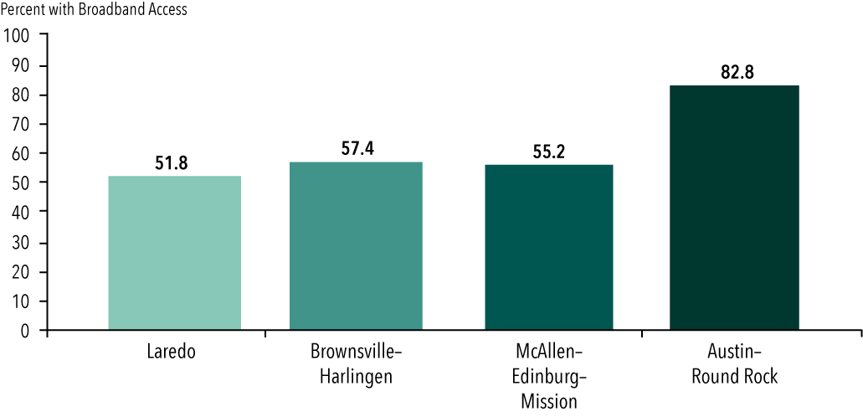
Digital Opportunity for the Rio Grande Valley (DO4RGV)
Of the 381 metropolitan areas in the U.S., those with the lowest rates of computer ownership and Internet use include three Texas border metro areas.

Slide 27
Digital Opportunity for the Rio Grande Valley (DO4RGV): The Role of Local Governments
A community-led initiative to design and implement an effective model for closing the digital divide in the Rio Grande Valley on the South Texas Border.
Demonstration Project-Phase 1: WiFi mesh networks to provide broadband for 200 families. Phase 2: A middle mile (government-to- government) network for the City of Pharr and the Pharr-San Juan-Alamo School District (PSJA) to provide the “back haul” fiber optic infrastructure. Phase 3: Middle mile infrastructure in San Juan and Alamo.
All Phases: A bilingual digital inclusion program at PSJA for parents and students.
Provide an adaptable and replicable model for the border region.

Slide 28
Project Goals
Improve the ability to provide for public safety.
Improve educational opportunity and results for Pre-K through 12 grade students and their families across the Rio Grande Valley region (close the "homework divide").
Improve access to workforce opportunities, including training and job opportunities.
Improve access to healthcare and telehealth.

Slide 29
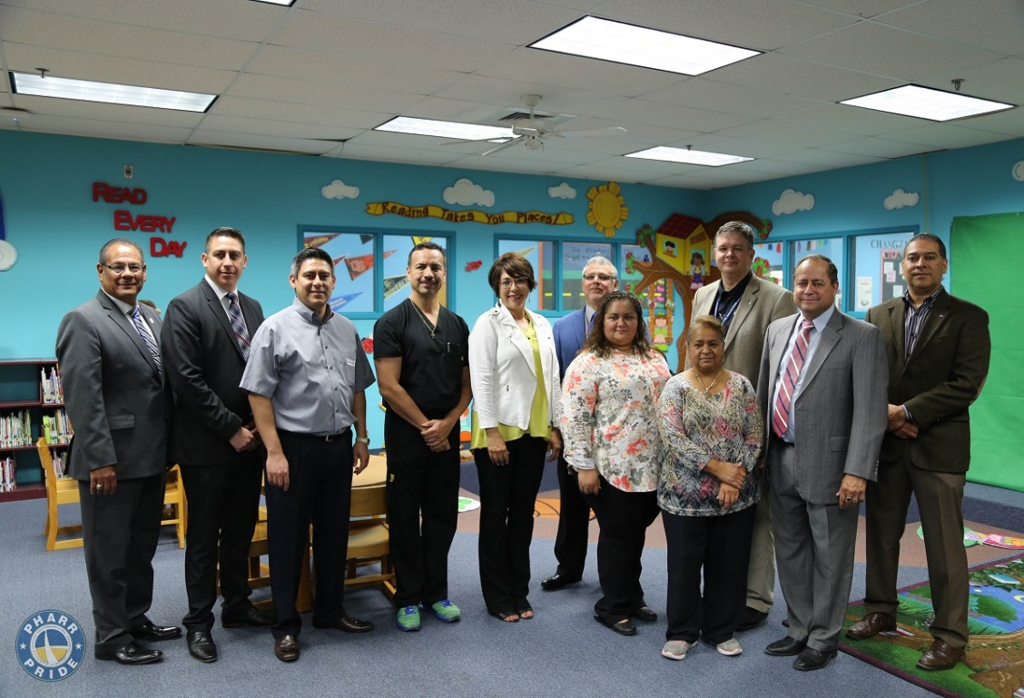
Project Goals
Improve access to the Internet and online marketing for entrepreneurs in the region and increase the ability to attract business.
Improve efficiencies for border trade
Improve access to financial services and online banking.
Improve financial literacy through access to training in using online, mobile banking, and financial technology apps

Slide 30
Funding the “three legs of the stool” of broadband adoption
New Markets Tax Credits-NMTC for broadband infrastructure
Interim Construction Loans
Equity Investments
Investment or grant for a CDFI or community loan fund that provides loans for broadband expansion in low- and moderate-income areas
Low-income Housing Tax Credits (LIHTC)
Grants or loans for broadband infrastructure (WiFi Mesh Networks, etc.)
Grants for strategic engineering plans for broadband projects
Matching grants for broadband infrastructure projects
Grants for digital inclusion programs: Digital skills in workforce development, training programs for small businesses, financial literacy for online & mobile banking, etc.

