Slide 1
Talent-Connect: Visualizing the long-term goals for Rockport-Fulton as a Start UP Community.

Slide 2
The Facilitating Our Future Series
The crafting and sustainment core of the CASU model is to provide Rockport-Fulton with the support to promote a robust entrepreneurial ecosystem.
Historically, the most successful Start UP’s have a well-formed “Talent Connect” capability that nurtures and promotes a resilient organizational ecosystem.

Slide 3
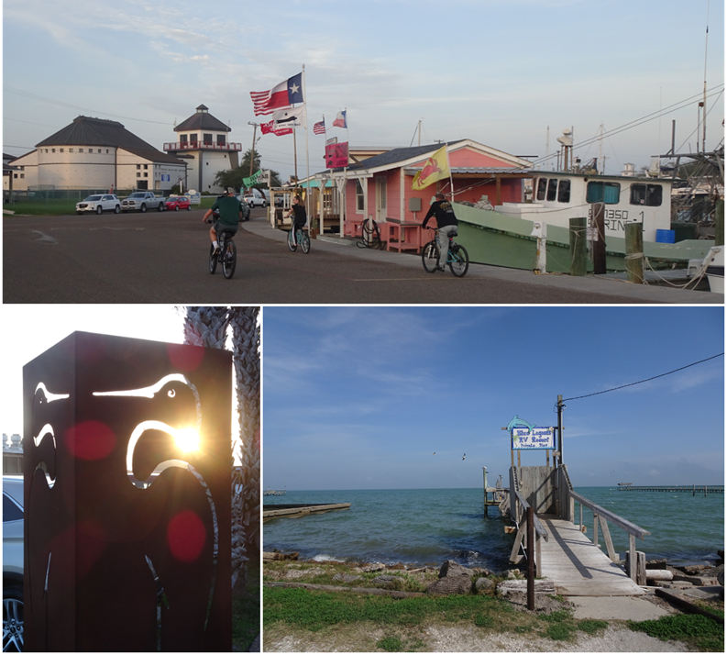
The Facilitating Our Future Series
In order to create the “Talent Connect” framework, it is important to focus on the Rockport-Fulton Value Proposition: Rockport/Fulton is poised to offer visitors and residents an elevated coastal experience. By highlighting the access to Rockport/Fulton’s pristine environment, active arts community, abundant seaside activities, and family-friendly atmosphere, Rockport/Fulton can attract the people, investment, and resources it will need to build the economy for its future.

Slide 4
The Facilitating Our Future Series
What is the “Talent Connect” concept?
A pool or an identified collection of QUALIFIED CANDIDATES (QC) that will create new opportunities, open new businesses, provide new jobs, OR be available to fill existing opportunities and positions.
A pool or an identified collection of experienced MENTORS, ADVISORS, COACHES, & CONSULTANTS (MACC) devoted to help the QC achieve their goals and meet the expectations of the community.

Slide 5
The Facilitating Our Future Series
TEAM Center and Talent Connect
A pool or an identified collection of QUALIFIED CANDIDATES (QC) that will create new opportunities, open new businesses, provide new jobs, OR be available to fill existing opportunities and positions.
The TEAM Center
A pool or an identified collection of experienced MENTORS, ADVISORS, COACHES, & CONSULTANTS (MACC) devoted to help the QC achieve their goals and meet the expectations of the community.

Slide 6
The Facilitating Our Future Series
What is the “Talent Connect” concept?
TEAM Center
A pool or an identified collection of QUALIFIED CANDIDATES (QC) that will create new opportunities, open new businesses, provide new jobs, OR be available to fill existing opportunities and positions.
A pool or an identified collection of experienced MENTORS, ADVISORS, COACHES, & CONSULTANTS (MACC) devoted to help the QC achieve their goals and meet the expectations of the community.

Slide 7
The Facilitating Our Future Series
The BENEFITS of the “Talent Connect” framework.
Reduced time-to-outcome cycle.
New opportunities are more efficiently located, developed, and launched.
New participants (QC and MACC) are more effectively identified, trained, supported, and productive.
Focused on long-term possibilities with less short-run churn.
Improved participant experiences and success.

Slide 8
The Facilitating Our Future Series
Generate Community Model Canvas(s) for the project

Slide 9
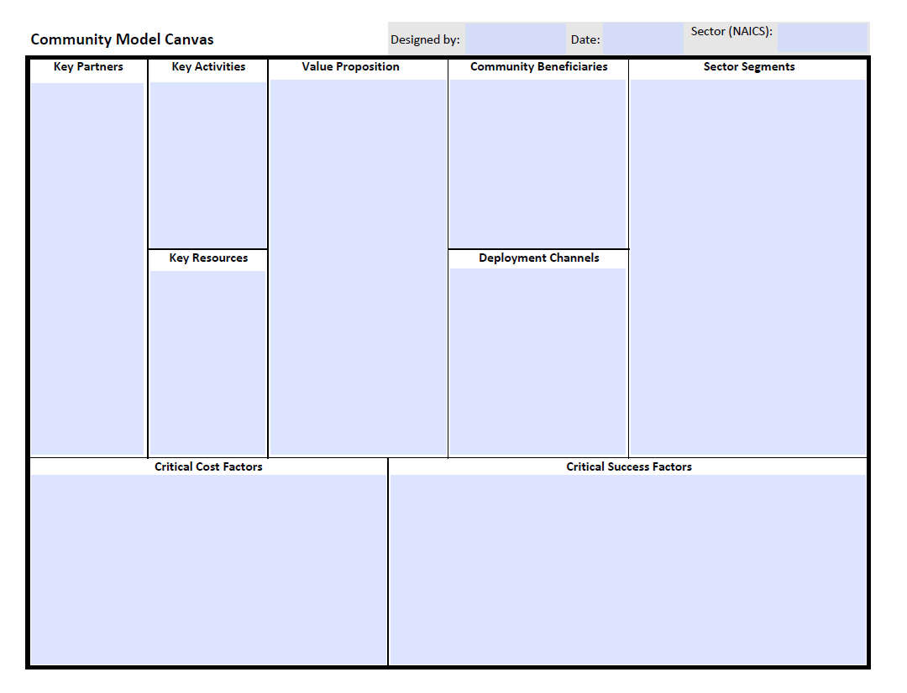
The Facilitating Our Future Series
2
The attributes and benefits that the Talent Connect concept will provide to each segment
3
The benefit from the success of the QC pool segment
1
QC Pool
Technology Candidates
Entrepreneur Candidates
Art Candidates
Maker Candidates
5
The most important partners to deliver the attributes and benefits to segment
7
Delivery process
6
Resources to deliver benefits to segment
4
The methods for communicating and engaging segment
8
Capital costs, operational costs, administrative costs maintenance costs, promotional costs, etc.
9
Measures and metrics for success: numbers of QC, availability of QC, location of QC, size of QC opportunity, etc.

Slide 10
The Facilitating Our Future Series
Steps in the creation and sustainment of the Rockport-Fulton “Talent Connect” framework.
Align the segments (pools) to the long-term desires and aspirations of the community.
Two TECHNOLOGY pools……… QC and MACC
Two ENTREPRENEUR pools…. QC and MACC
Two ART pools………………..…… QC and MACC
Two MAKER pools…………..…… QC and MACC In time these will “Cross-Pollinate” which will enhance and expand the value to the community.
Technology-Art Pools
Maker-Art Pools
Maker-Art-Technology-Entrepreneur Pools
Entrepreneur- Maker Pools
Art-Entrepreneur Pools
Technology-Entrepreneur Pools

Slide 11
The Facilitating Our Future Series
Essentials for the “Talent Connect” framework.
Align the segments (pools) to the long-term desires and aspirations of the community.
Develop a sourcing strategy for each TEAM pool set (QC and MACC).
Create a methodical and detailed database.
Establish and maintain contact with the participants in each pool as they are identified.
Create assessment criteria.

Slide 12
The Facilitating Our Future Series
Know the two sides of the “Talent Connect” framework
Qualified Candidates (QC)
What do they value?
Where do they see themselves fitting in the community?
What services will help them grow their opportunities?
Can the opportunity increase job creation?
MACC Participants
What is their value-add?
What services can they provide and is there a need?
Do they understand the QC’s goals and expectations?
Can they help the QC increase job creation?

Slide 13
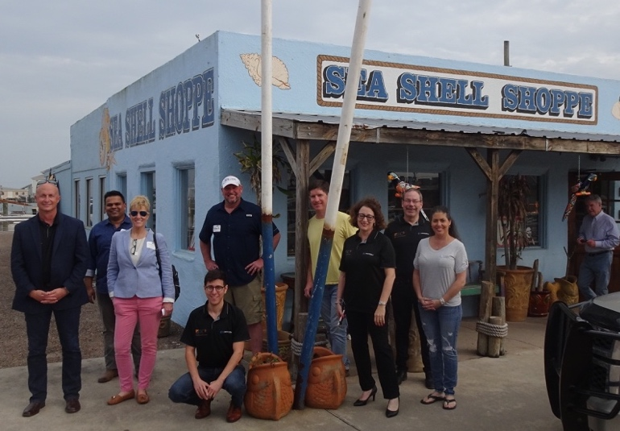
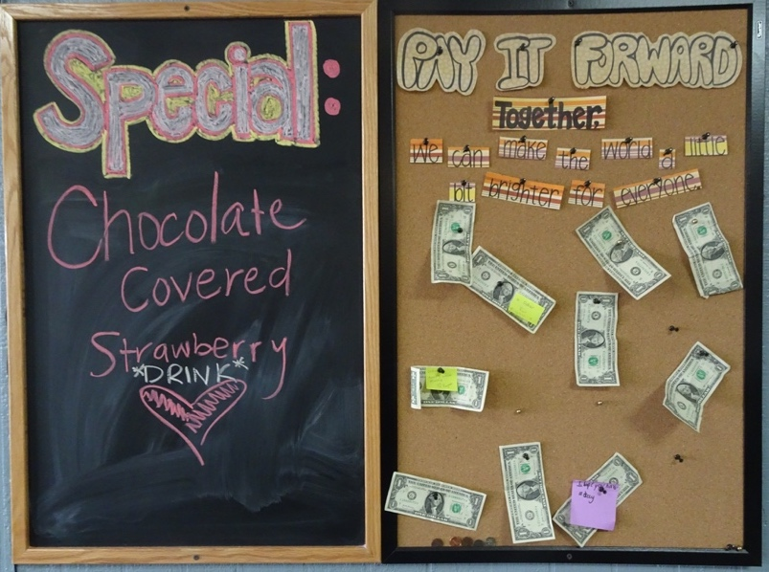
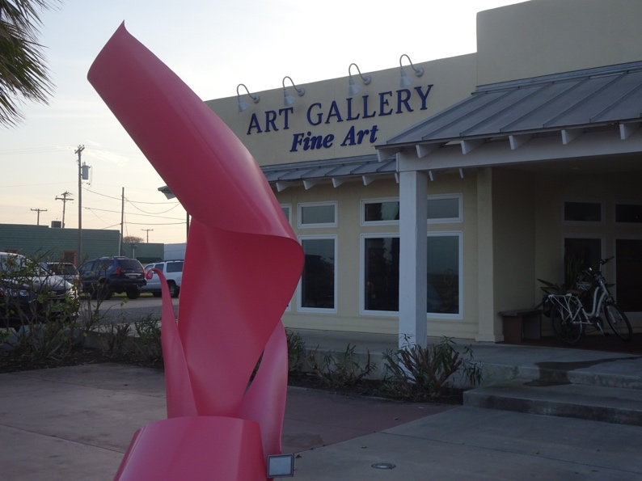
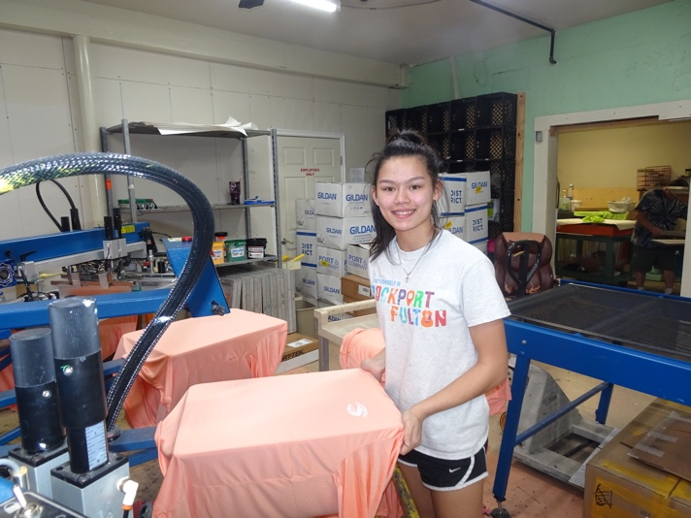
The Facilitating Our Future Series
Thank You for Your Participation.
Questions and Answers

