Slide 1

Creating an entrepreneurial ecosystem as a structural imperative for the CASU model.

Slide 2

The Facilitating Our Future Series
StartUP enterprises and small businesses are at the core of the economic vitality of the Coastal Bend Region of Texas.
The “Communities As Start UP” (CASU) effort is an energy, activity, and innovation project that is designed to assist Rockport-Fulton as the community continues to emerge from Hurricane Harvey and the Covid-19 pandemic.
The core of the CASU program is to provide the community (as a whole) with the support to promote a robust entrepreneurial ecosystem.

Slide 3
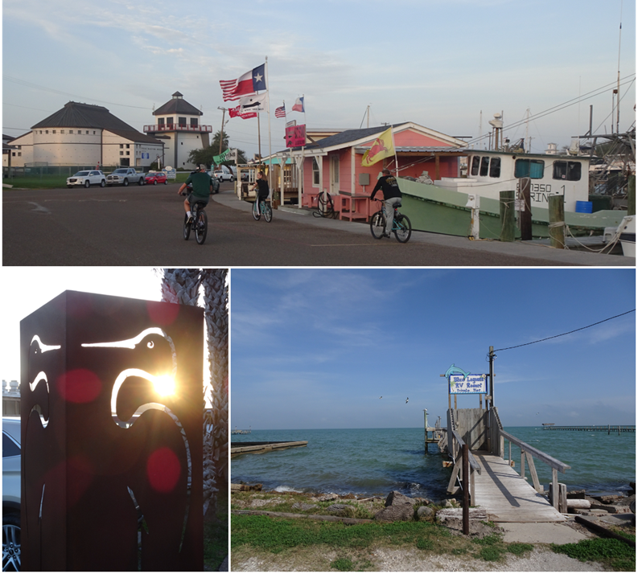
The Facilitating Our Future Series
The Rockport-Fulton Value Proposition:
Rockport/Fulton is poised to offer visitors and residents an elevated coastal experience. By highlighting the access to Rockport/Fulton’s pristine environment, active arts community, abundant seaside activities, and family-friendly atmosphere, Rockport/Fulton can attract the people, investment, and resources it will need to build the economy for its future.

Slide 4
The Facilitating Our Future Series
Community Aspirations refer to the community resident’s shared goals, beliefs, and expectations. There are different categories of aspirations, each provide a greater understanding of the community. Based on a preliminary inquiry, the Rockport-Fulton residents aspire for a community that is:
Safe and Protected – a community that is free from violent crime, with first responders who work together to protect each person. Where people are physically safe and where medical and mental health care is available when needed. A community where communications and public utilities are both modern and reliable
Future Facing – a community that protects the natural beauty, with community leaders who work together to plan the future. Where there are strong public education opportunities for each child, and where everyone can enjoy good food and fun in a clean environment, with residents who can count on each other.
Diverse and Prosperous – a community that values work and where differences are respected. Where everyone can be successful and where people can secure good paying jobs.
Vibrant and Visionary – a community that is physically healthy, with easy access to outdoor activities. A community without the signs of aging/crumbling. A community with variety, energy, and enthusiasm that is innovative when confronting issues.
Supportive and Nurturing – a community where basic needs of everyone are met with a sense of order. A community that fuels creativity and where young people can find a job that is interesting and personally fulfilling.
Just Plain Popular – a community that everyone finds attractive and is well known by many different people.

Slide 5
The Facilitating Our Future Series
Review of September 16, 2020
  Reviewed Phase 1:
  3-Day Leadership Discussions.
  Identified 16 Key Findings.
  Explained 4 Key Strategies.
  Specified 4 Significant Challenges.
  Delivered a Rockport-Fulton Value Proposition.
  Proposed 6 Consideration Points for Implementation.
Review of October 14, 2020
  Defined the role and characteristics of community aspirations.
  Identified 6 significant and shared aspirations for the community to be:
    Safe and Protected
    Future Facing
    Diverse and Prosperous
    Vibrant and Visionary
    Supportive and Nurturing
    Just Plain Popular
  Provided a general overview of the next step, an exploration of the entrepreneurial ecosystem.

Slide 6
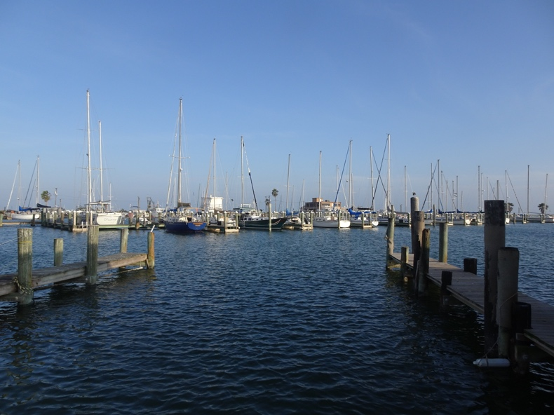
The Facilitating Our Future Series
An entrepreneurial ecosystem of a community consists of the physical environment and all possible interactions between and among the dynamic complex to organize, create, and sustain entrepreneurship. There are four broad components:
  Institutional components and participants to legitimize, regulate, and incentivize entrepreneurship.
  Public resource endowments of essential utilities and infrastructure, basic knowledge, financing mechanisms, and pools of competent labor to support entrepreneurial activities.
  Market demand of informed consumers for the products and services offered by entrepreneurs.
  Proprietary business activities that private entrepreneurs are will willing, able, and authorized to engage in exploitation of compatible opportunities.

Slide 7
The Facilitating Our Future Series
The presence of these components and the level of success and competence for each must be captured, inventoried, and understood in relation to the ideals, expectations, aspirations, and limitations of the community within which they exist.
  Are the institutions aligned, appreciated, and effective for the growth of the entrepreneurial ecosystem?
  Are the public resources available, adequate, and agile enough to support the entrepreneurial ecosystem?
  Are the market demanders sufficiently large, accessible, differentiated, and responsive to sustain the entrepreneurial ecosystem?
  Are the proprietary businesses purposefully unified, complementary, diverse, and stable for the prosperity of the entrepreneurial ecosystem?

Slide 8
The Facilitating Our Future Series

Slide 9
The Facilitating Our Future Series

Slide 10
The Facilitating Our Future Series

Slide 11
The Facilitating Our Future Series

Slide 12
The Facilitating Our Future Series

Slide 13
The Facilitating Our Future Series

Slide 14
The Facilitating Our Future Series

Slide 15
The Facilitating Our Future Series

Slide 16
The Facilitating Our Future Series

Slide 17
The Facilitating Our Future Series

Slide 18
The Facilitating Our Future Series

Slide 19
The Facilitating Our Future Series

Slide 20
The Facilitating Our Future Series

Slide 21
The Facilitating Our Future Series

Slide 22
The Facilitating Our Future Series

Slide 23
The Facilitating Our Future Series

Slide 24
The Facilitating Our Future Series

Slide 25
The Facilitating Our Future Series
Recommendations for Entrepreneurial Ecosystem Exploration
  Explore the extent to which the institutions aligned, appreciated, and effective for the growth of the entrepreneurial ecosystem.
  Establish a short-medium-and long-range assessment for determining the best ways to enhance the availability and exploitation of public resources to support the entrepreneurial ecosystem.
  Perform a long-range market assessment of the demander to determine the sufficiency of size, accessibility, differentiation, and responsiveness to product offerings to focus on the most sustainable within the entrepreneurial ecosystem?
  Determine whether the existing businesses mis is purposefully unified, complementary, diverse, and stable to secure the prosperity of the entrepreneurial ecosystem?

Slide 26
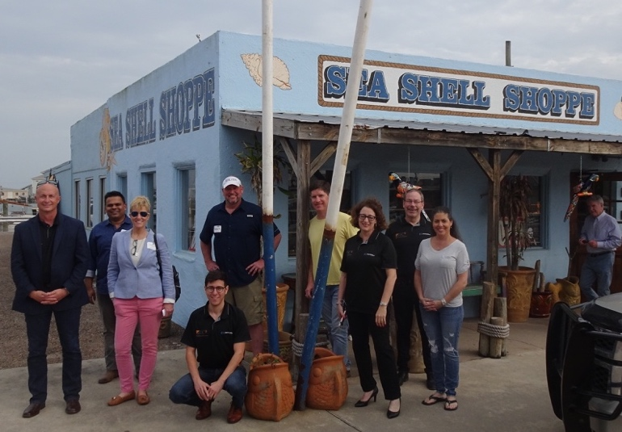
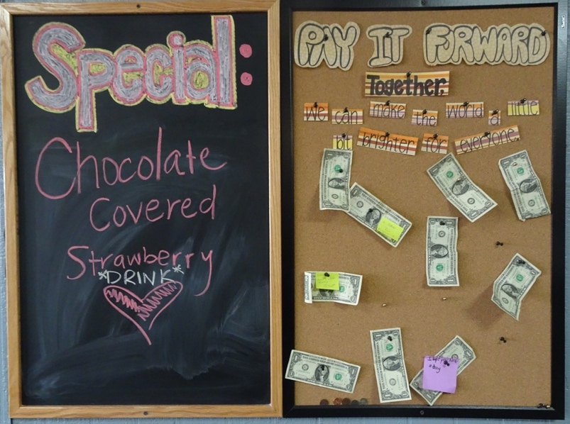
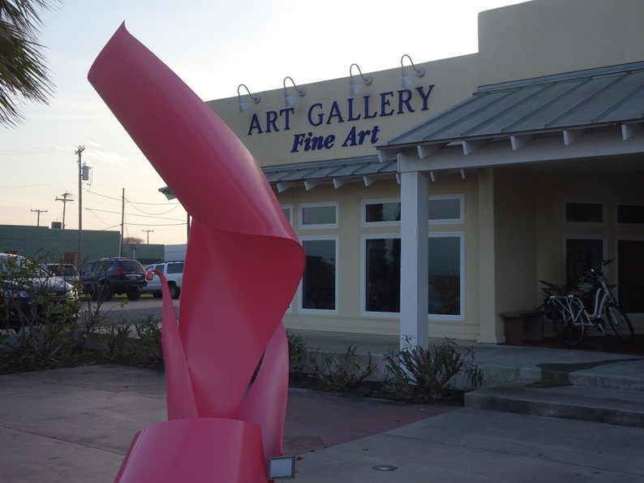
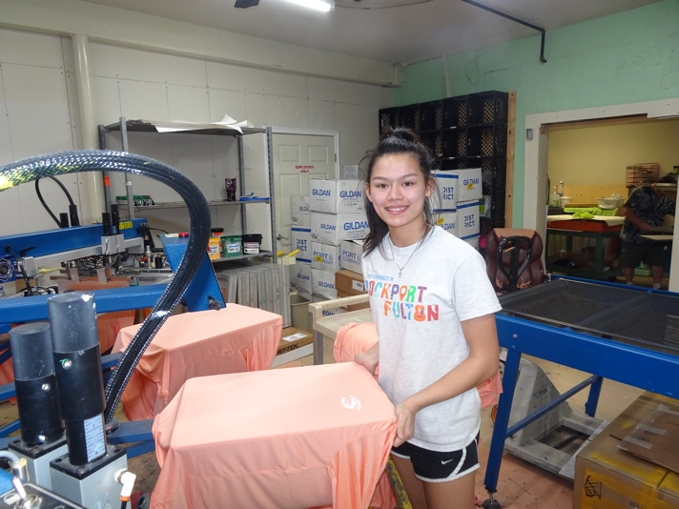
The Facilitating Our Future Series
Thank You for Your Participation.
Questions and Answers

