Slide 1
Resilient Communications for Public Safety– Driving Your Own Strategy
Andrew Afflerbach, Ph.D., PE
September 2018

Slide 2
Public safety a critical priority
Disaster response and recovery—storms, fires
Major incidents– active shooter
Major events—Super Bowl
Day-to-day response and operations
Notifications to and from the public
REQUIRES A WIDE RANGE OF METHODS AND TECHNOLOGIES AND KNOWLEDGE OF EACH MOVING PART

Slide 3
Selected strategies
Land-mobile push-to-talk radio—still central
FirstNet—National Public Safety Broadband Network (wireless broadband) driven by AT&T
And other commercial mobile broadband
Dedicated private networks
Fiber backbones
Wireless, sometimes using public safety spectrum

Slide 4
Why a private network?
Knowledge of exact routes, switching, capacity limits, redundant electronics
Hardened power and backup power
Diverse physical routes
Ability to manage restoration and repair
Can leverage other government infrastructure
Towers, conduit, utility pole lines
Government and educational institutions can act as anchors and create scale to make it affordable

Slide 5
Private Network Considerations
Ongoing operational cost
Attracting and maintaining skilled staff
Keeping up with technology and security threats
Appropriate balance of in-house and outsourcing/partnership
Regulatory risks– spectrum, preemption

Slide 6
Fiber Optics Provide Flexiblity, Scalability and Resilience
Provides a logical backbone infrastructure
No intermediate electronic devices required
Physically rugged and long-lasting
Each strand can deliver hundreds of Gbps
Hundreds of separate strands per cable
Each can be secured
Separate institutions can be independent
Multiple public and private partners in shared infrastructure
Local or long-haul uses

Slide 7
KentuckyWired leveraging state and local anchor facilities

Slide 8
Example Fiber Allotment
Institutions as backbone hubs and shared meet points
Apportionment of strands among owners, governments, partners, customers
Backbone for other networks, including wireless

Slide 9
National Capital Region (NCRNet)
Washington DC and surrounding cities and counties
Fiber backbone begun after 9/11 failures
DHS funded
Public safety only
Independent of carrier infrastructure
Government, cable franchise, and leased fiber
Fully documented network, no use of carrier network switches

Slide 10
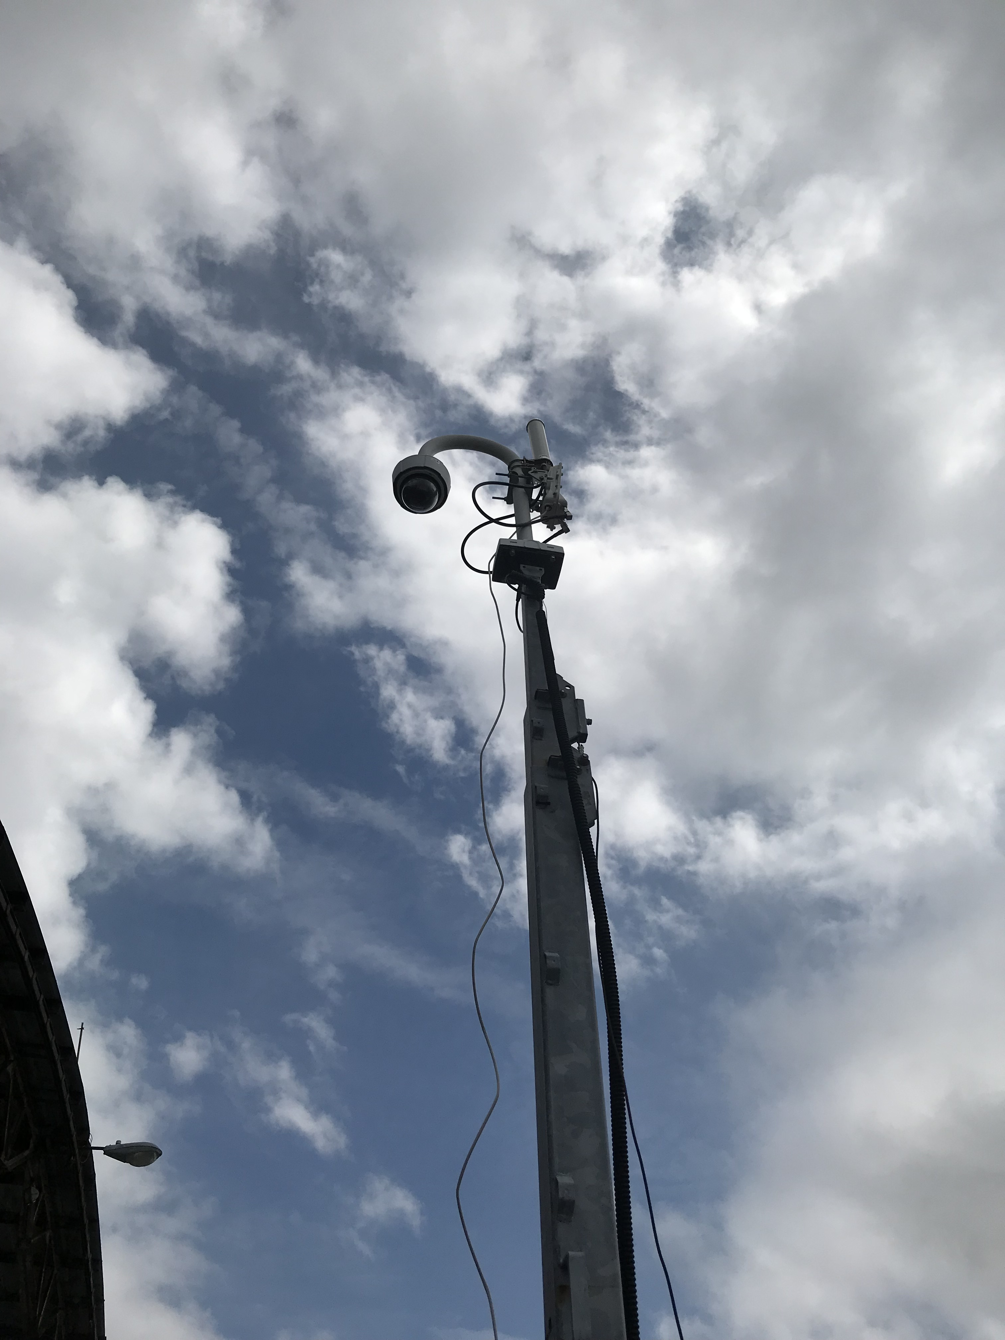
DelDOT Public Safety Wireless
Statewide wireless broadband network for fixed and nomadic use (command vehicle and incident)
Protected public safety 4.9 GHz frequencies
Connected to State fiber backbone
DOT, first responder, public information use
Typical 10 mile range, 100 Mbps
Different uses than FirstNet
Faster to build and cheaper than fiber– “extension cord”
Funded in State budget

Slide 11
Network Resiliency and Security Playbook
Best practices in planning, implementing and operating resilient and secure infrastructure
Why state and local government infrastructure is at risk– physical, cyber, human factors
Multilayered approach to mitigate risks
Lifetime costs, training, working regionally, information security, leveraging free and inexpensive resources
Available at http://www.ctcnet.us/library/

