Slide 1
Broadband Network Design, Business Model, and Partnership Strategy
Andrew Afflerbach, Ph.D., PE
September 2018

Slide 2
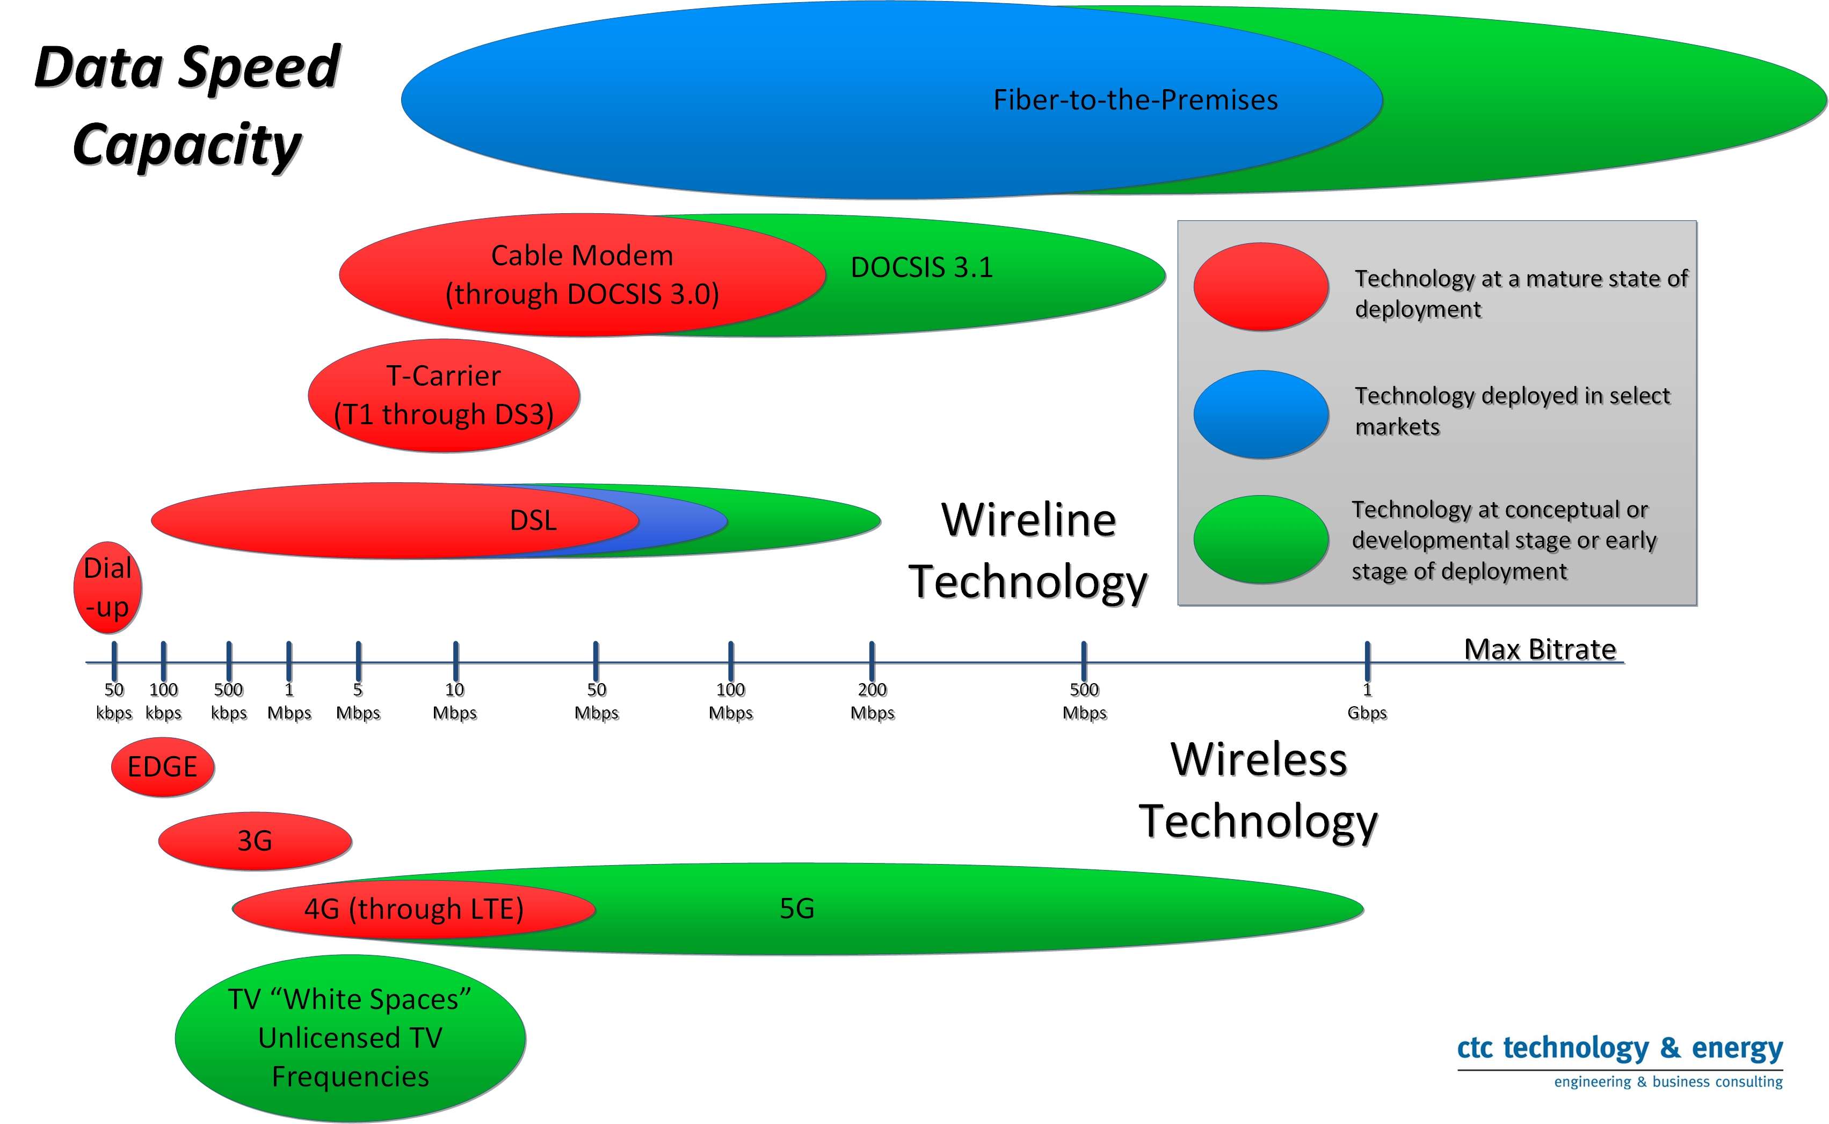
Broadband Ecosystem

Slide 3
Multi-phase strategy, with public-private collaboration
Phase 1. Public sector facilities
  Business case is internal savings and efficiencies, public safety and resiliency
Phase 2. Key economic development targets
  Business case is economic development
Phase 3. Platform for last mile deployment
  Business case is economic development, private sector opportunity, service improvement
Public infrastructure, with private service delivery though public-private collaboration

Slide 4
Phase 1: The basic financial business case
How to analyze the Phase 1 financial case for public fiber to connect public facilities:
  Scalability and hedging against cost increases over time
  Internal operations and operational efficiencies
  Emergency response and disaster recovery
  Regional collaboration
  Smart applications
  Community resilience

Slide 5
Phase 1: Analyze internal savings and efficiencies
Reduced costs from current leasing expenditures—current and future
  IT and other public sector staff
  Public safety
  K-12 and community colleges
  Libraries
  Critical community anchors such as evacuation shelters and foodbanks

Slide 6
Phase 1: Avoided costs, future growth
Understanding avoided costs for future, growing use
Imagine unconstrained use
Operational efficiencies
Hardware and software efficiencies
“Smart” applications and devices/sensors
Assume exponential growth of need
Build your hedge

Slide 7
Phase 2: Route fiber to pass key economic development target areas
Deploy fiber strategically, with focus on key economic development targets
Historic downtowns, rehab areas, business parks
Connect to Internet peering point (could be local meet point)
Public entity builds & owns infrastructure, and works with a private partner who will serve customers and other ISPs
Public-private collaboration enables pricing designed to support anchor entities and attract ISP customers

Slide 8
Phase 2 case study: Westminster, MD
Public deployment and ownership of fiber
  Prioritize business areas & parks, historic downtown revitalization area
Private sector service to these businesses
City is infrastructure owner only
Private partner responsible for:
  Equipment to “light” fiber
  Marketing and sales
  Services
  Customer service
  Billing and collections
Very high “take rate” by businesses who previously struggled

Slide 9
Phase 3: Private partner leases services to ISPs for expansion to homes and small businesses
Enormous capacity of fiber serves as platform for economic development, retail broadband opportunity
Private partner can serve as both wholesaler & retailer
Serves key target customers itself, and
  Also leases capacity to other ISPs that are focused on small business and residential opportunities
Pricing designed to enable new opportunity
Public-private collaboration designed to protect the asset

Slide 10
Phase 3 Case Study: City of Huntsville, AL
Publicly-owned infrastructure, financed over decades, enable cost efficiencies that support the effort and enable private opportunity
  Fiber deployment for internal purposes
  Long-term financing and business plan
  Strategic routing for economic development
  Private partner for provision of services (and for phases 2 and 3)

Slide 11
Phase 3 case study: Holly Springs, NC
Public deployment and ownership of backbone fiber
  Prioritize business areas & parks, historic downtown revitalization area
Private sector deployment to residences and businesses
Ting selected as private lessee of fiber
Ting has built fiber to all homes and businesses
  Equipment to “light” fiber
  Marketing and sales
  Services
  Customer service
  Billing and collections

Slide 12
Phase 3 Case Study: OneMaryland
Public fiber network to serve public entities, with private service provision for residential and commercial customers
  Statewide fiber to public facilities
  Collaboration between state and counties
  Excess capacity for economic development leased to Maryland Broadband Cooperative
  Cooperative provides services to commercial users and to ISPs such as Verizon and cell companies
  Remarkable use of Cooperative services by small ISPs in rural Appalachia and on Eastern Shore of Chesapeake Bay

Slide 13
Phase 3 Case Study: Lexington, Kentucky
State and city fiber assets leased to private entity that is building to the home and business
  Middle mile fiber to public facilities
    Funded from savings/avoided costs
  Excess capacity for economic development
  Metronet committed to building to the home and business, leasing public assets

Slide 14
Phase 3 Case Study: Fayette County, Kentucky
Economy dependent on large horse farms and other rural employers
City/county fiber to reach key employers as well as public facilities
    Funded from fees paid by large employers for enterprise level services
Excess capacity for economic development

Slide 15
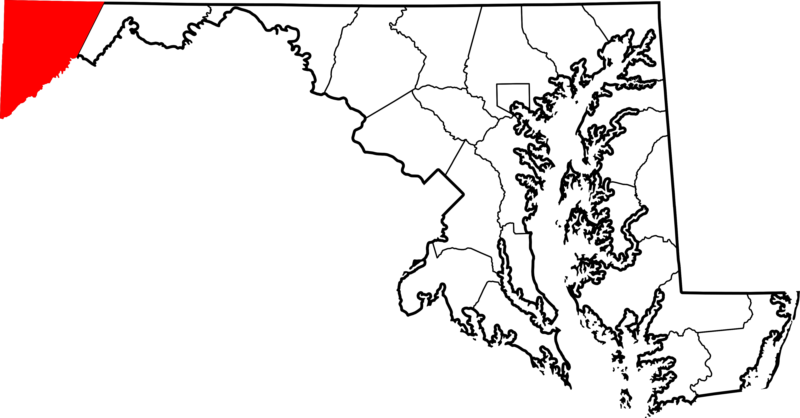
Model 3 Case Study: Garrett County, MD
Underserved rural areas
Fiber construction strategy for key anchors
Public/private wireless to key target areas
Public risk contained

Slide 16
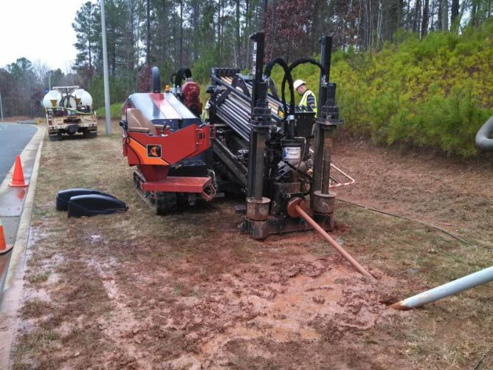
Phases 1-3 case study: KINBER, PA
Keystone Initiative for Network Based Education & Research
Phase 1: Statewide robust fiber rings built for K-12, higher ed, health care users
Phase 2: Passes business parks and key targets
  Designed strategically
  Enable service to homes & businesses in future
Phase 3: Partnership agreement with Sunesys (now Crown Castle)
  Sunesys leased excess fiber
  Sunesys serves commercial and ISP customers

Slide 17
Resources at www.CTCnet.us
Public-Private Partnerships
  Primer on emerging models for broadband public-private collaboration
Fiber Planning, Design, and Construction
  Multiple feasibility studies at citywide, statewide, and regional scales
Fiber, Network Security, and Protection Against Hacking
  Guidance document for protecting public fiber and network assets from bad actors

